Slide 1
SST pattern scaling
July 31, 2019

Slide 2
Where we at
Does the monthly pattern scaling work well enough, or do we need to do annual PS and pull monthly fractions from history?

Slide 3
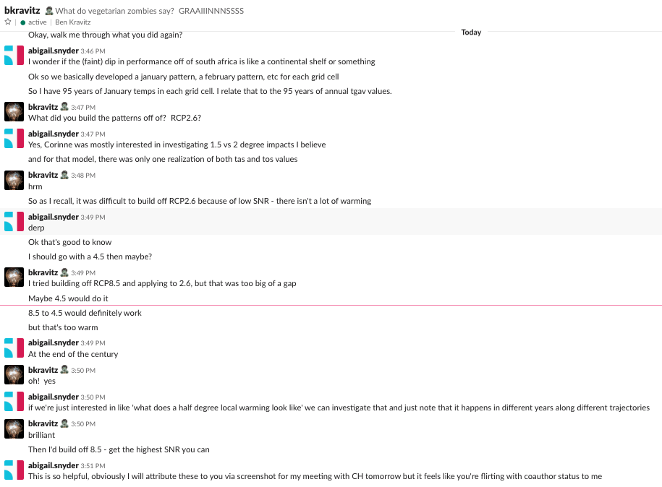
Some interesting patterns to the errors in pattern scaling from a 2.6
BK suggested looking at a 4.5 – turns out the weird patterns persist.
Does raise a point – we should select our training scenarios based on the experiments we want to run.

Slide 4
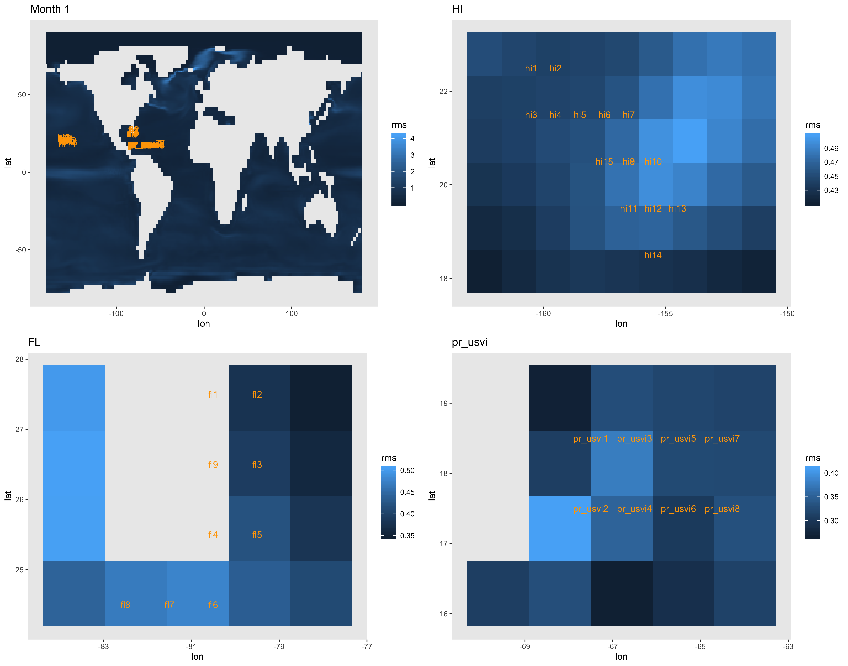
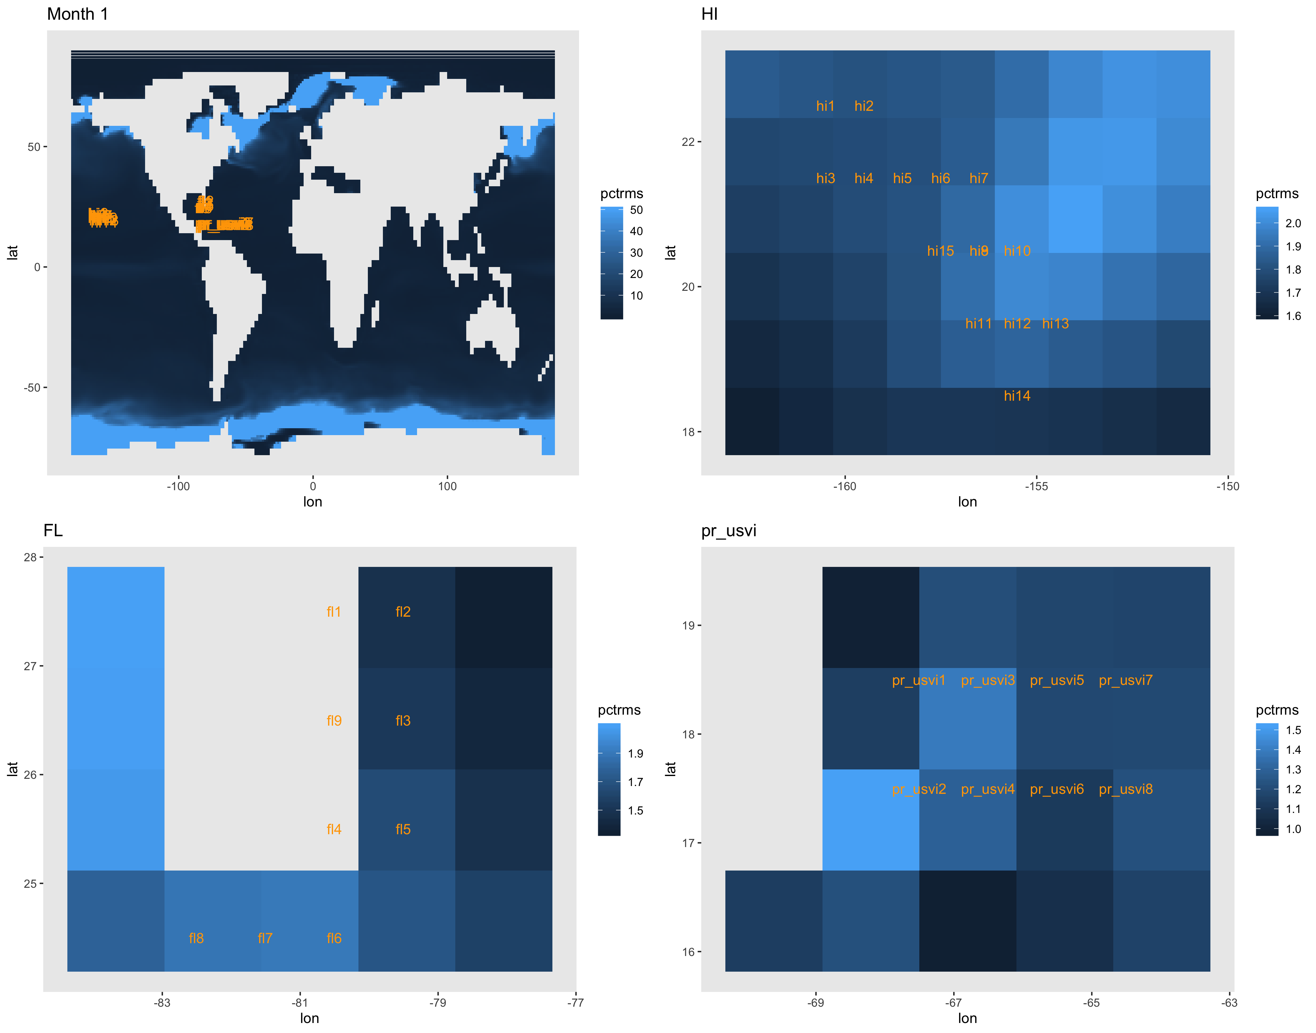
CanESM2 – RCP 2.6 – one realization

Slide 5
We are really answering two questions
How well can we pattern scale tos in general? Decently in a lot of places, but we fail quite a bit on seasonal patterns like the gulf stream and TICZ because we are at the monthly scale; my guess is that tas would struggle at the monthly scale similarly.
Interpretation from BK is that it makes sense pattern scaling will struggle on these kinds of signals: ‘It’s a huge anomaly from the mean, and it moves with season. The ITCZ in the tropics moves with season too.’ It’s interesting that we struggle on this even within each month - that suggests there’s still a lot of year-to-year variability in what the tos for January in the Gulf Stream values are. But I think he was initially thinking that was all annual values.
Also looks like some of it is sea ice boundaries, per BK.
This supports Robert’s position that we need a better method to get a monthly mean field that pulls out all of the seasonal signals before we can use fldgen to generate residuals at the monthly level (it’s likely that there will be some Gulf Stream effects in tas or pr too).
How does the pattern scaling of tos perform at the monthly level in the areas we want to analyze? Quite well because they’re tropic but not overly monsoony - the temperatures are relatively consistent

Slide 6
Implications for experiment
because of the actual rms values in degC in the areas of interest (off by .3-.6 degC in most of those cells), might need to look at 1, 1.5, 2, and 2.5 as scenarios, with the idea that the true 1.5 vs 2 difference is within that cone?
If the idea is that corals will be sensitive to a half degree change in tgav, we can still understand that - it’s just that like a hector pattern scaled local 2deg change might be more like the ESM local 2.5 or something. In other words comparing hector to hector scenarios is ok, but comparing hector to esm scenarios is a little more nuanced.

Slide 7
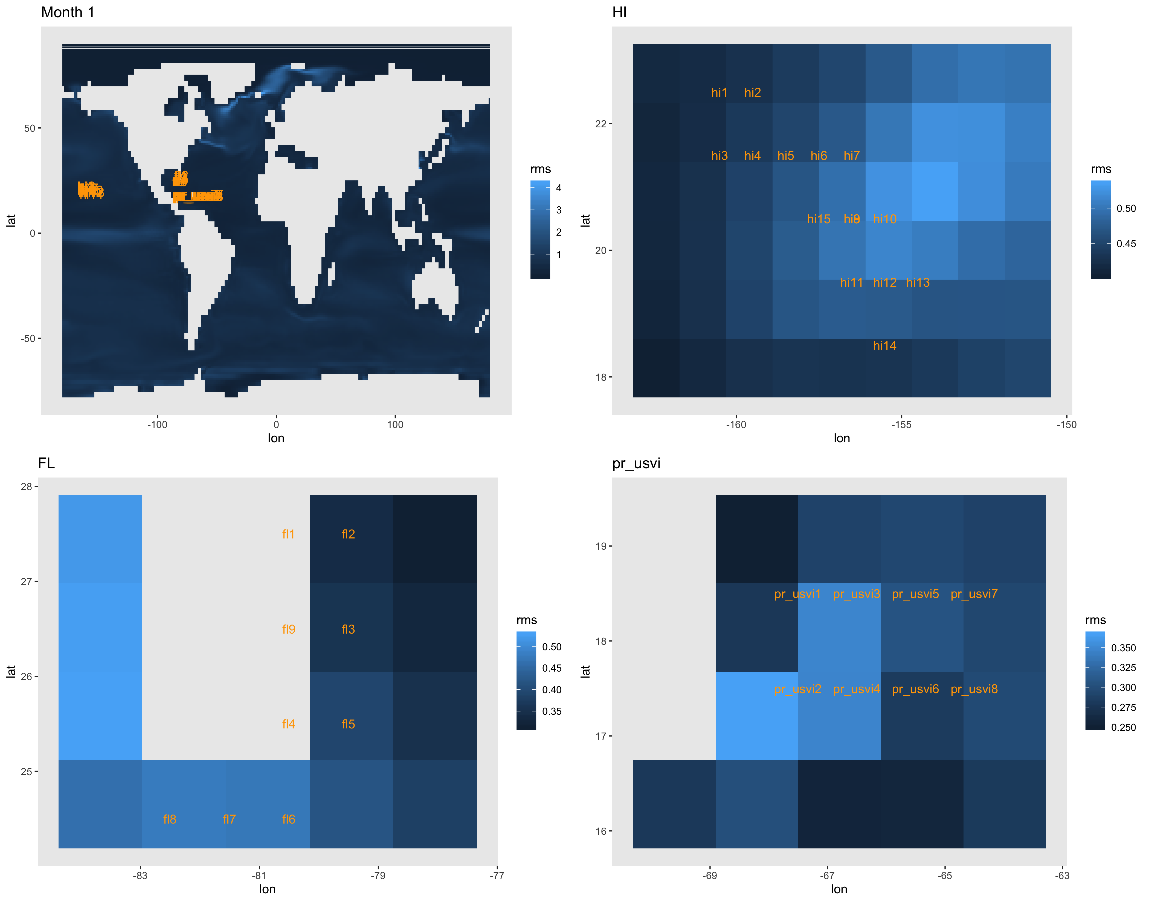
Errors from 2.6 with 1 realization, 4.5 with 5
At the coral sites, it doesn’t quite seem to matter. So the question is defending within the paper.
The errors do seem worse for tos than they were for tas and precip in BK and CL papers – kind of hard to tell from their maps
Also haven’t looked at other models. Think I have the analysis template now.

Slide 8
If we are happy with this monthly PS approach, we’re fine.
If we don’t think we have sufficiently validated monthly PS, I can check the annual pattern scaling and we can get the monthly fractions from historical.
Where to spend time next:
Annual might go better because fewer of those seasonal currents?
There have also been no constraints on our monthly patterns to see if they agree with annual averages – should at least check? Actually implementing such a constraint would be more difficult?
Monthly with other models?

Slide 9
All months 4.5

Slide 10
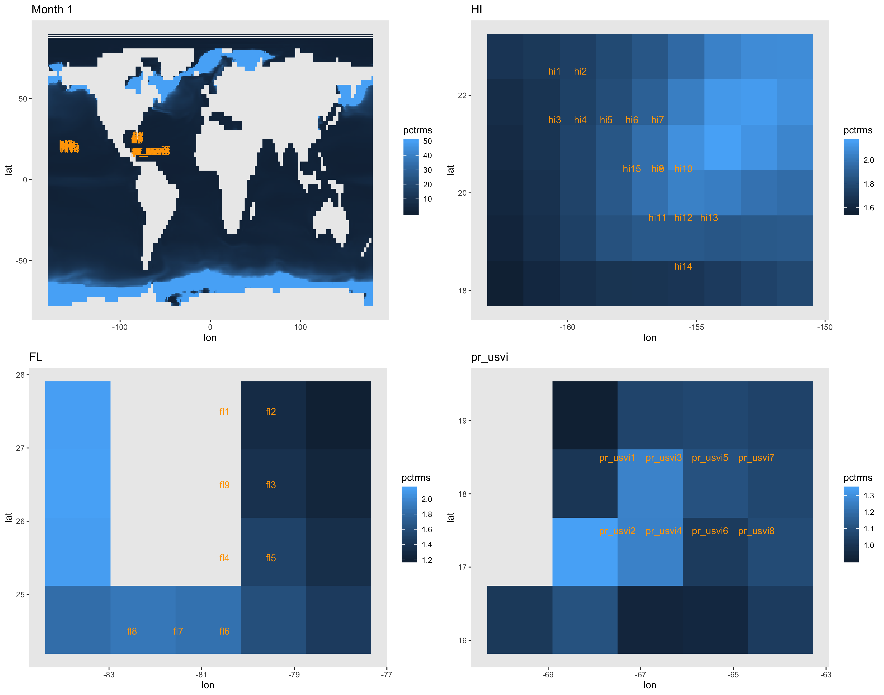

Slide 11
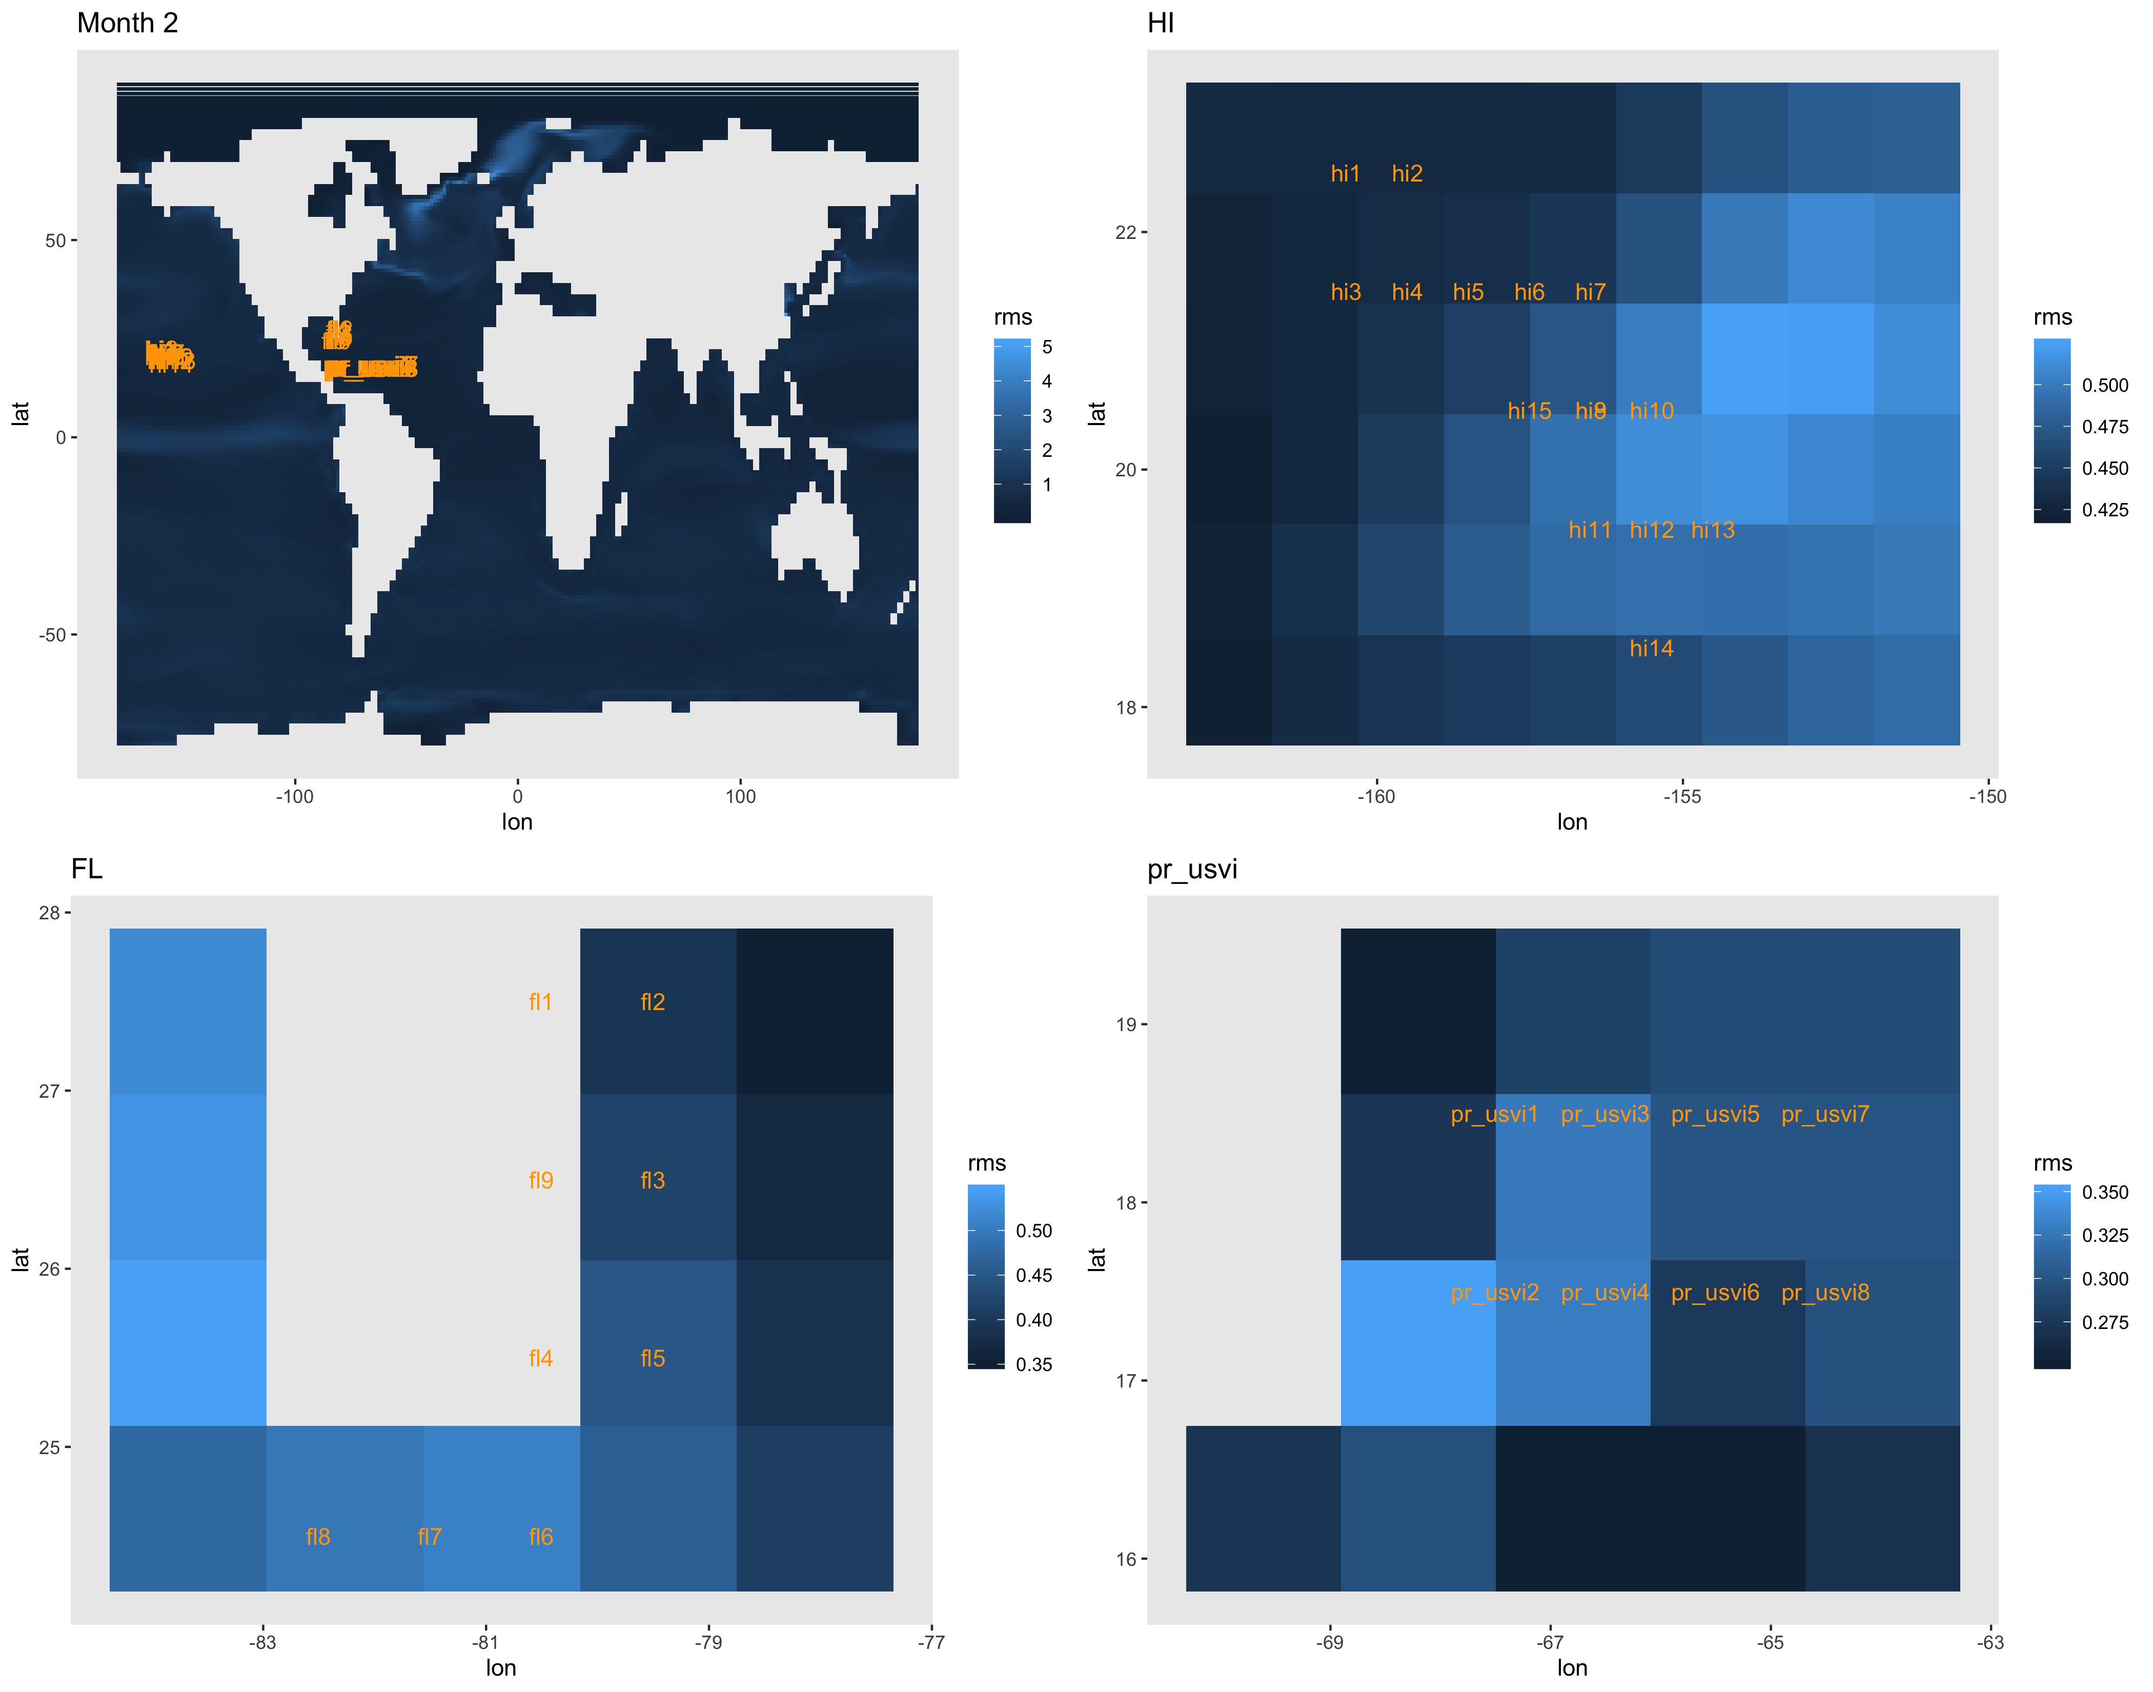
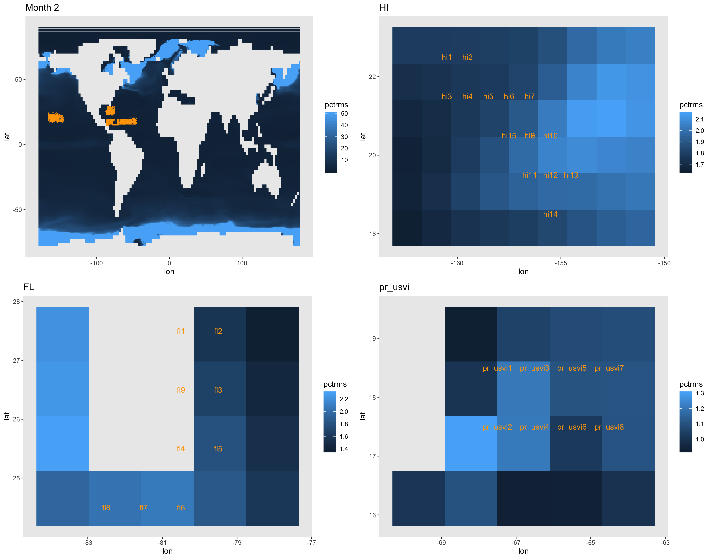

Slide 12
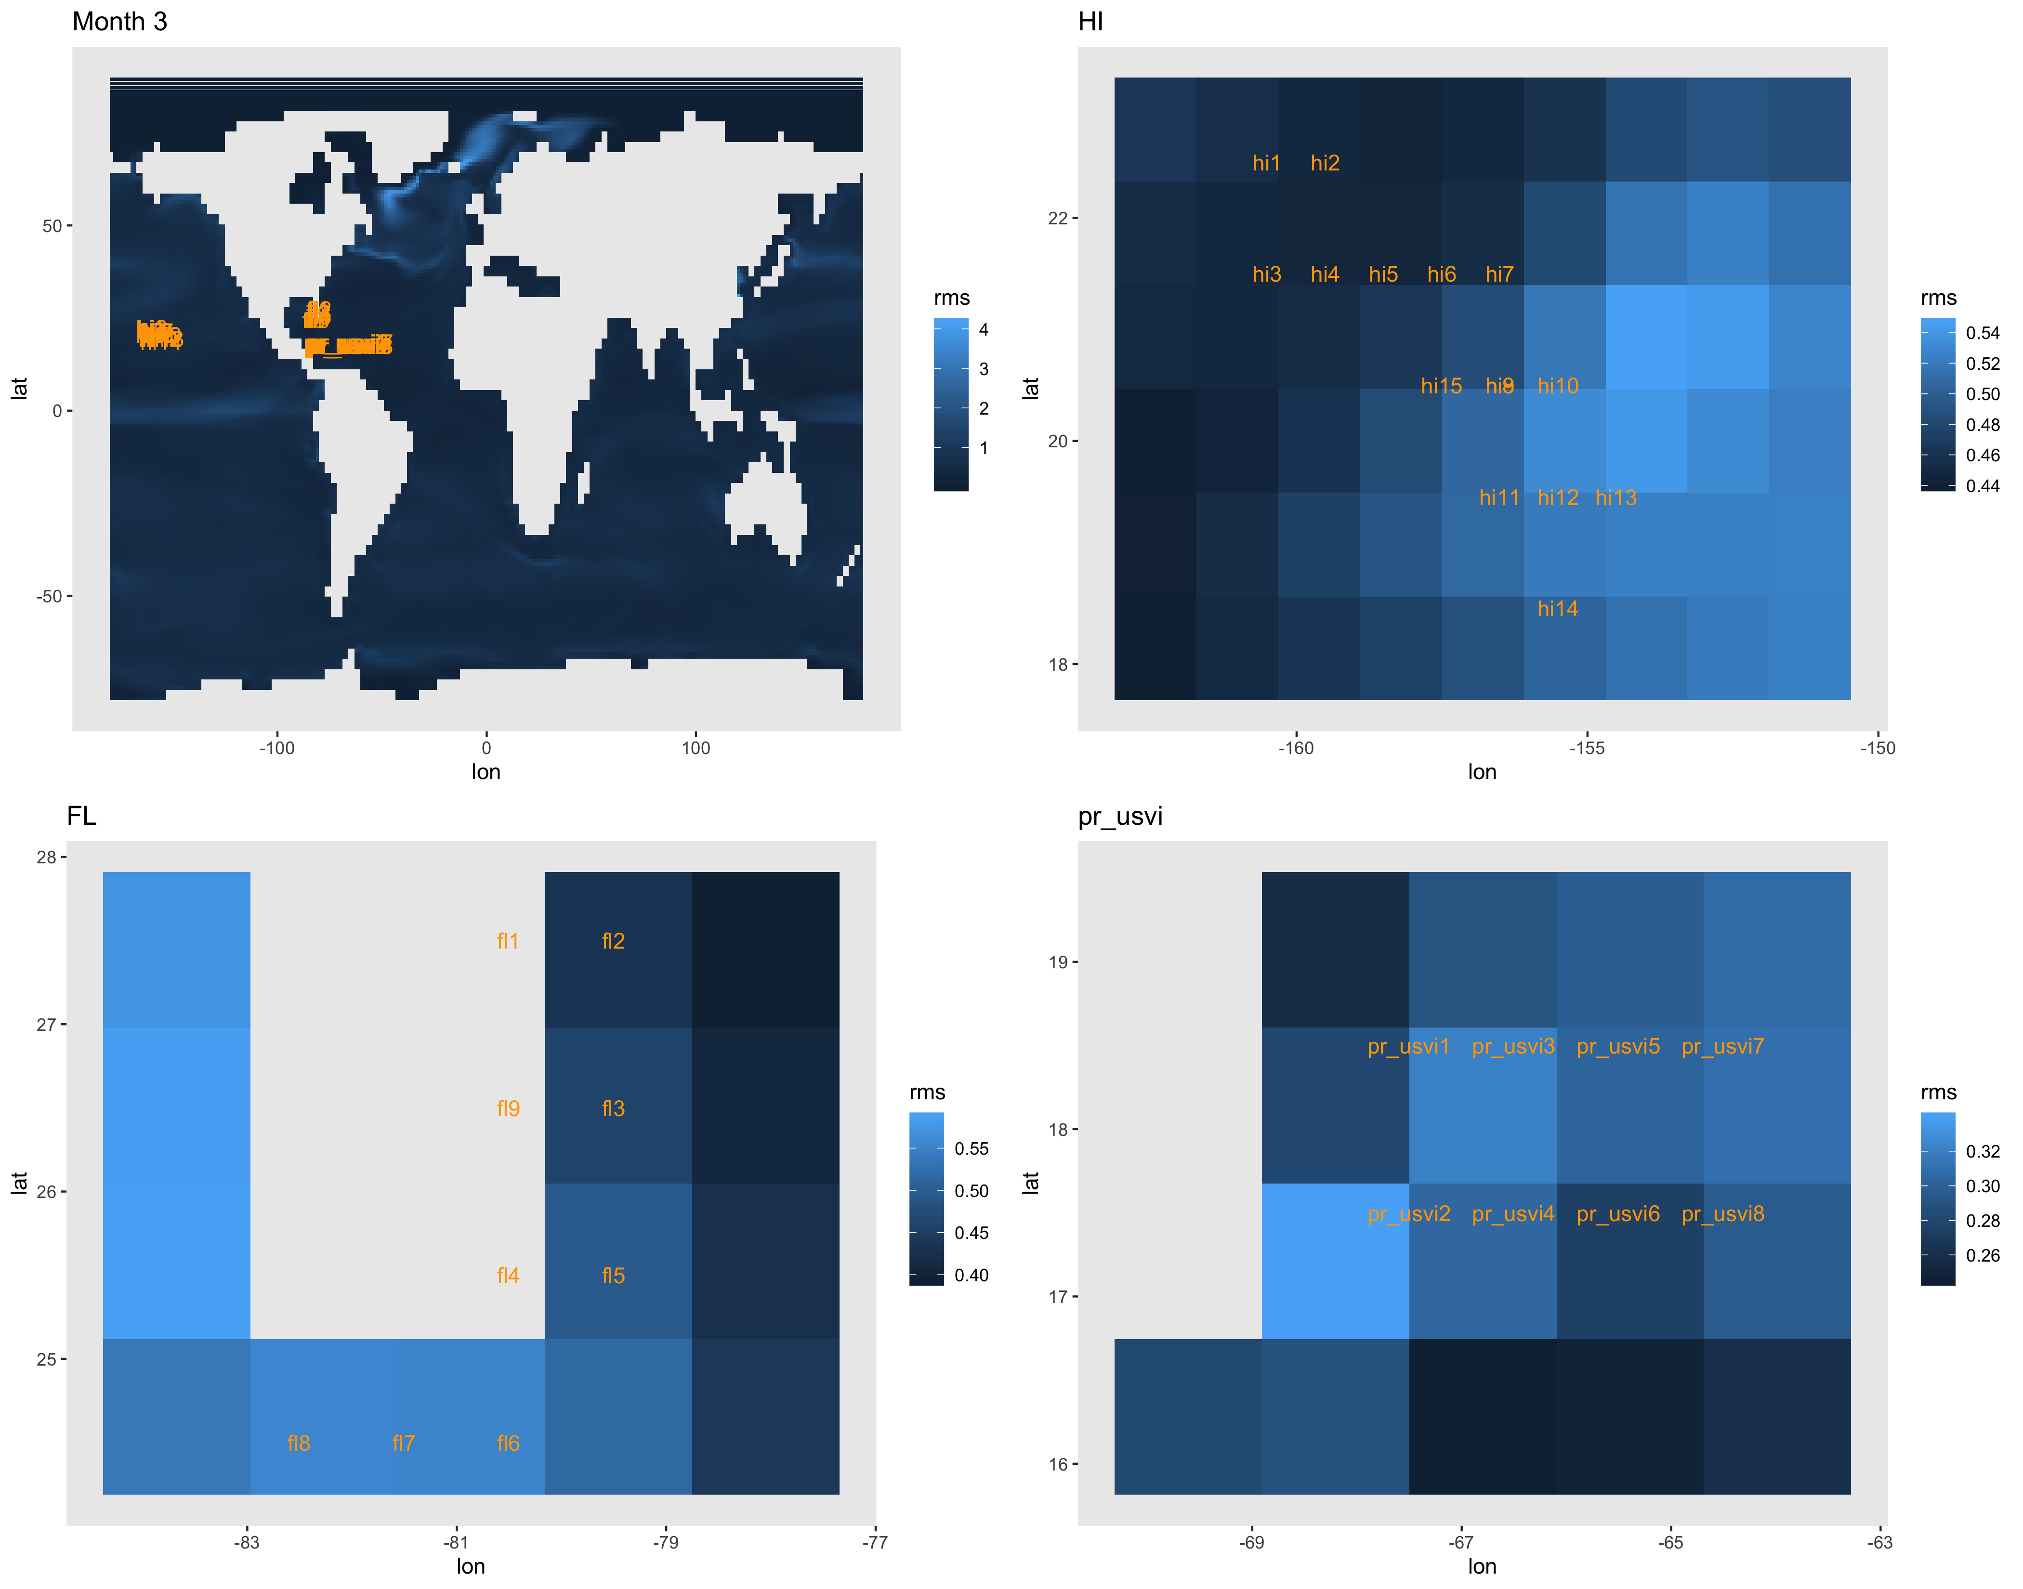
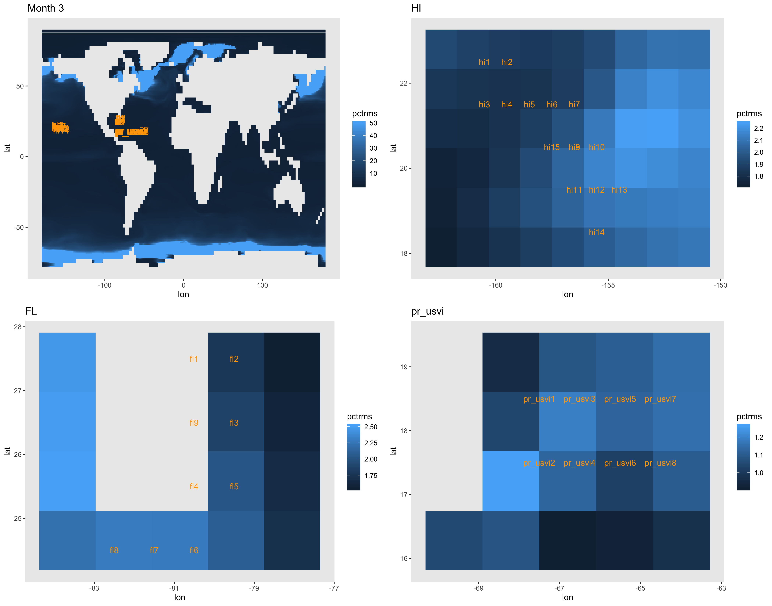

Slide 13
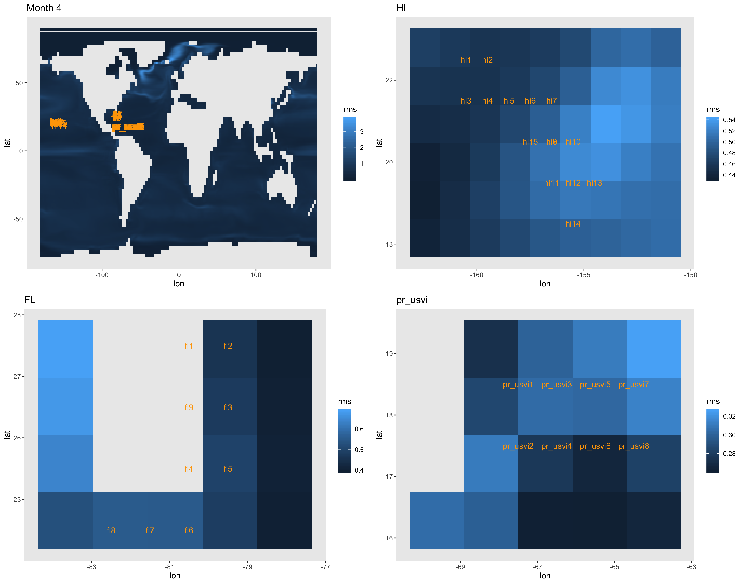
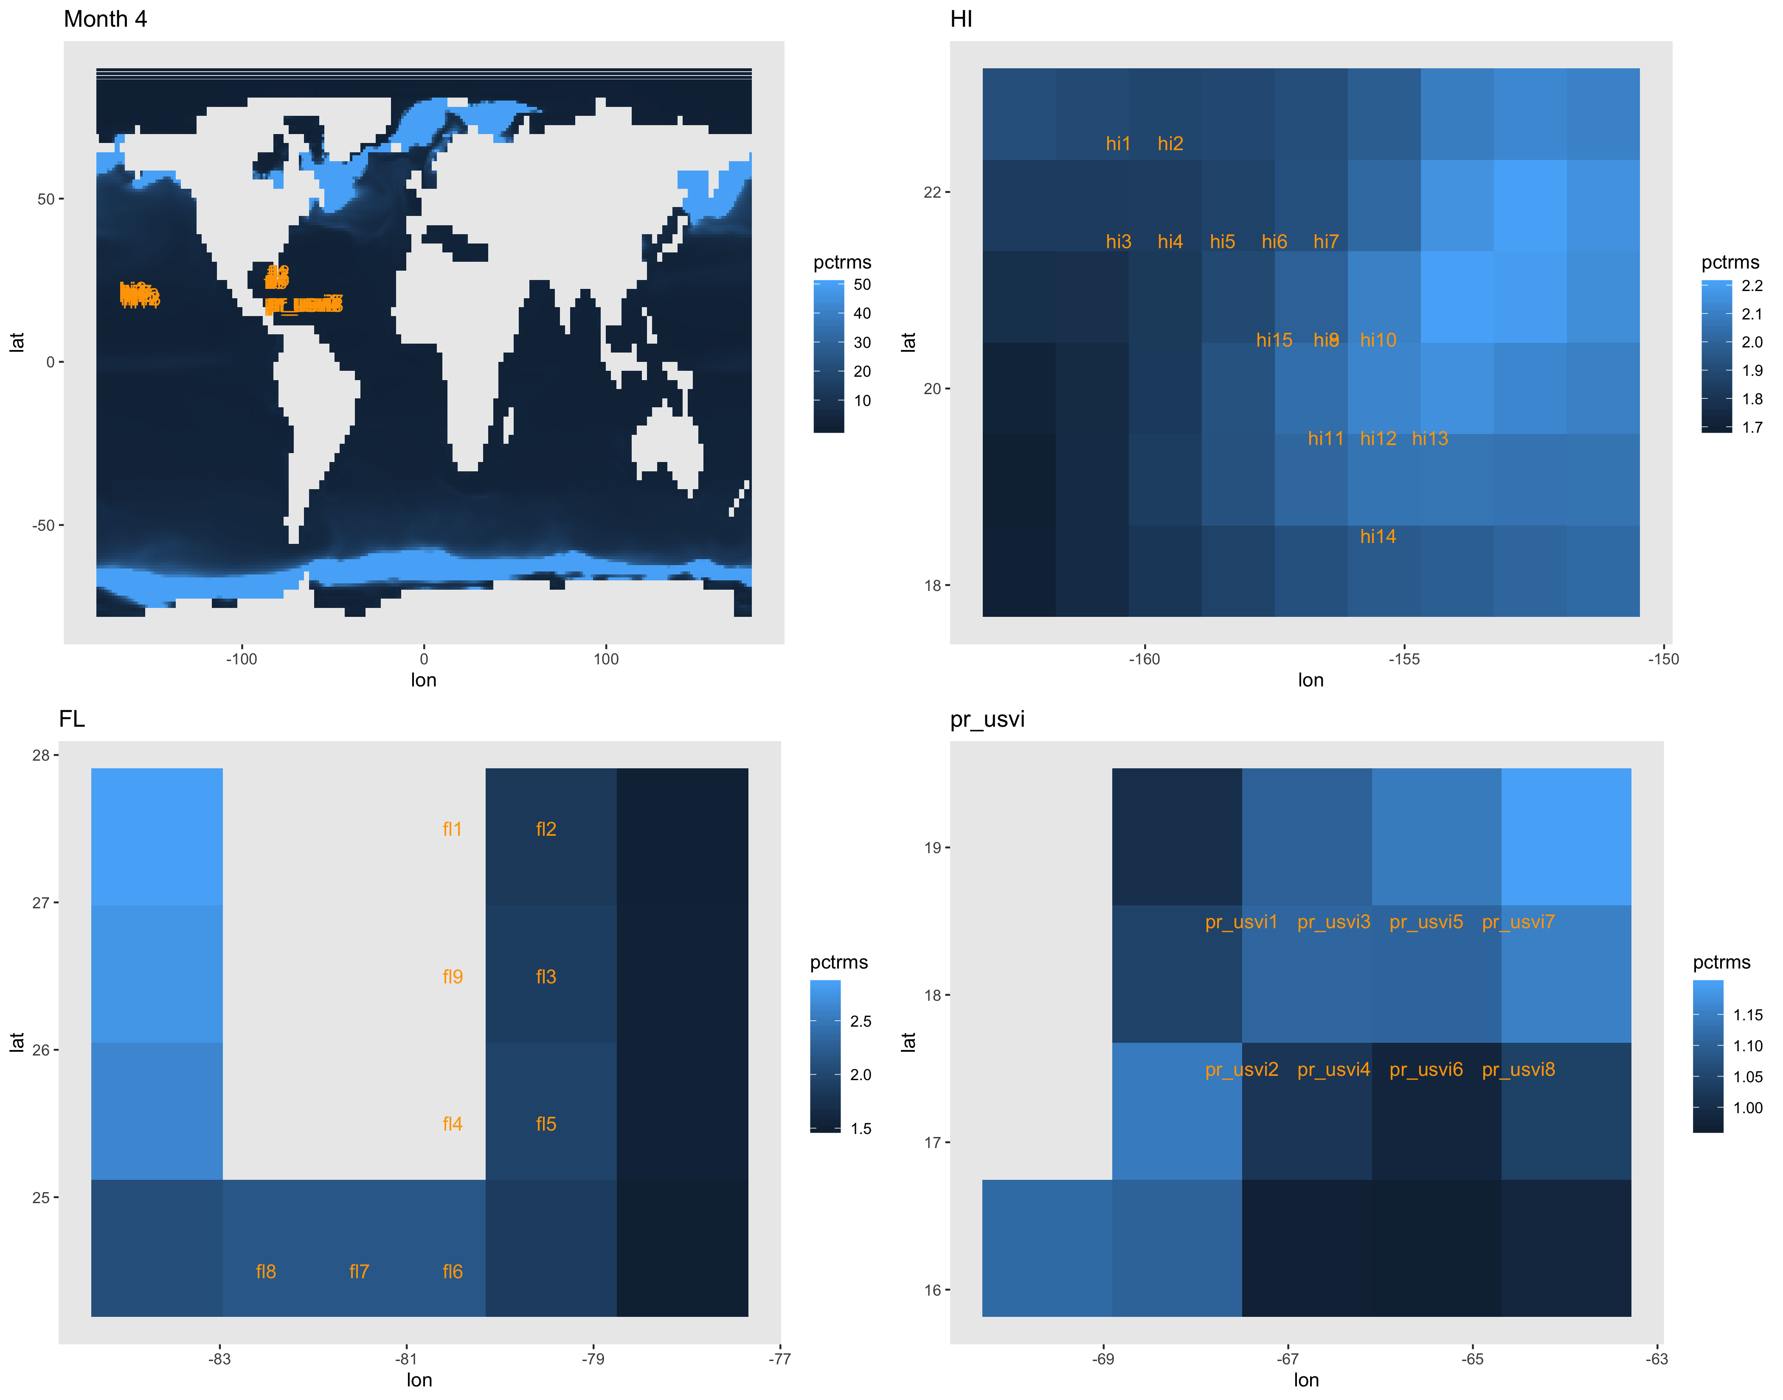

Slide 14
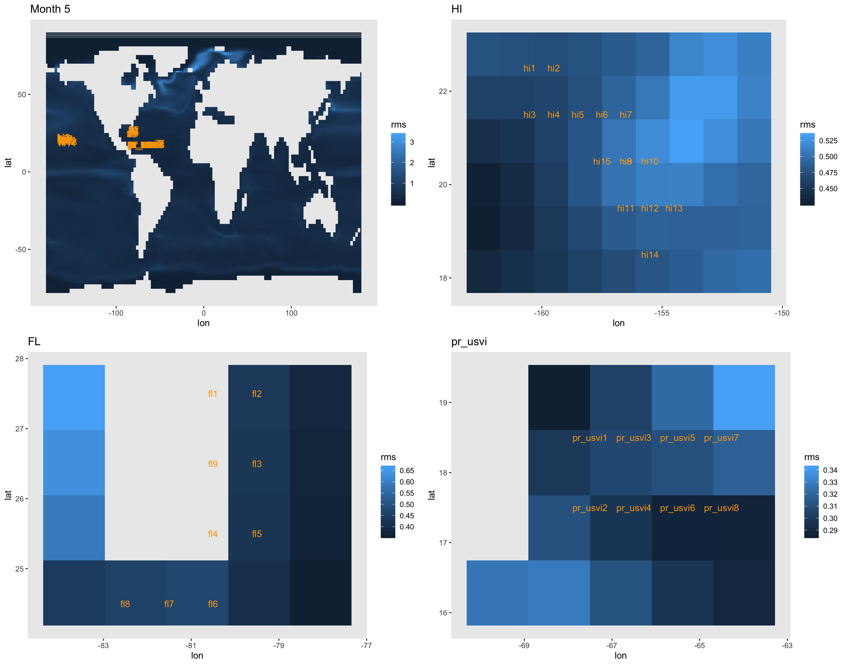
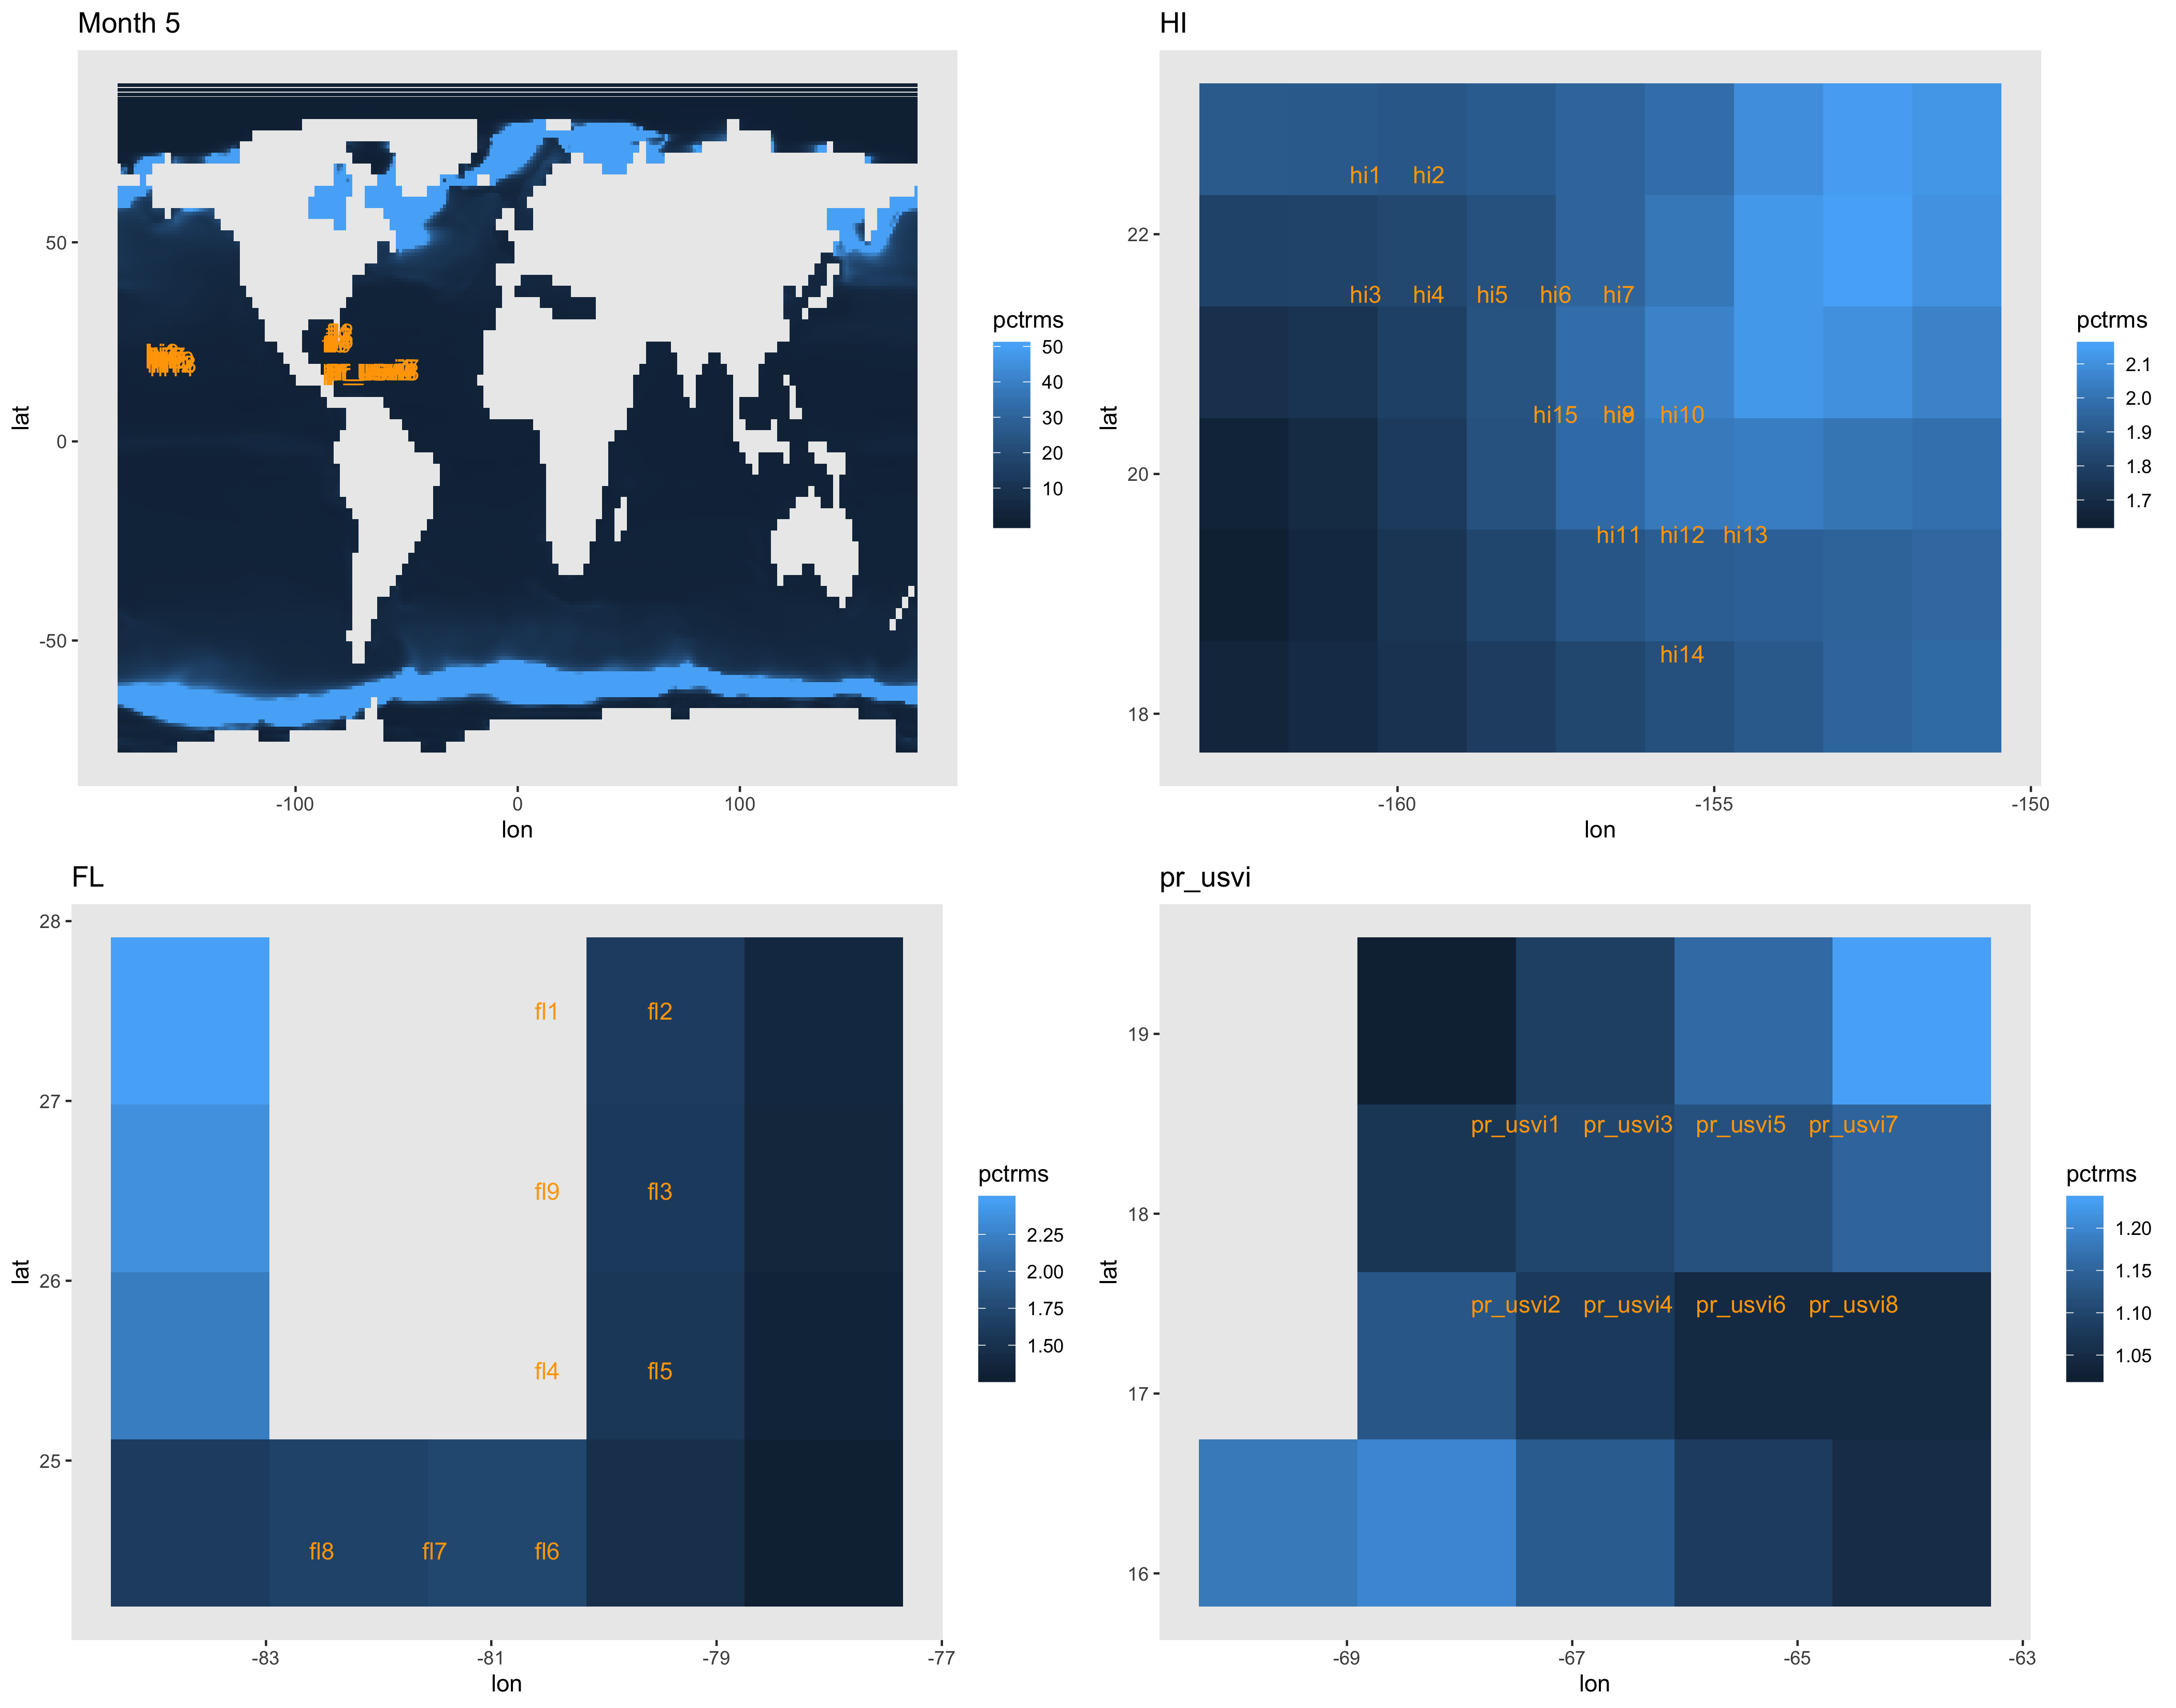

Slide 15
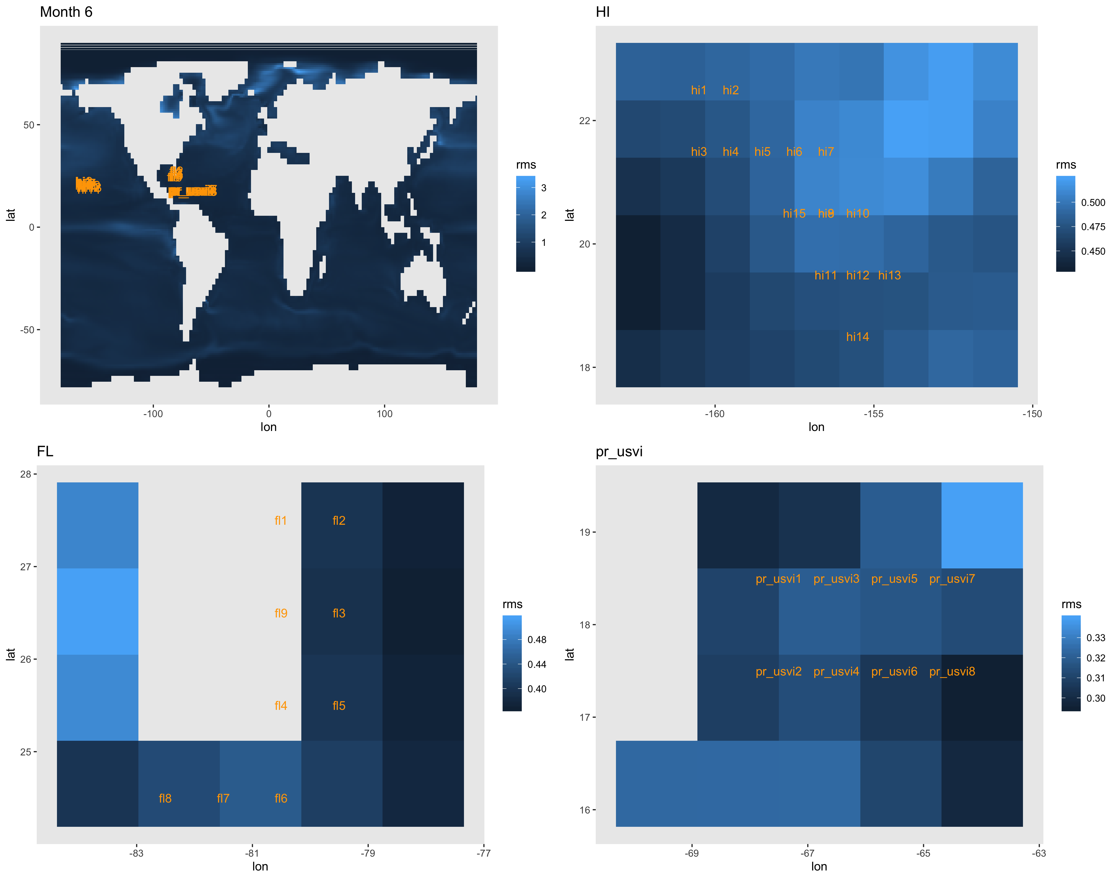
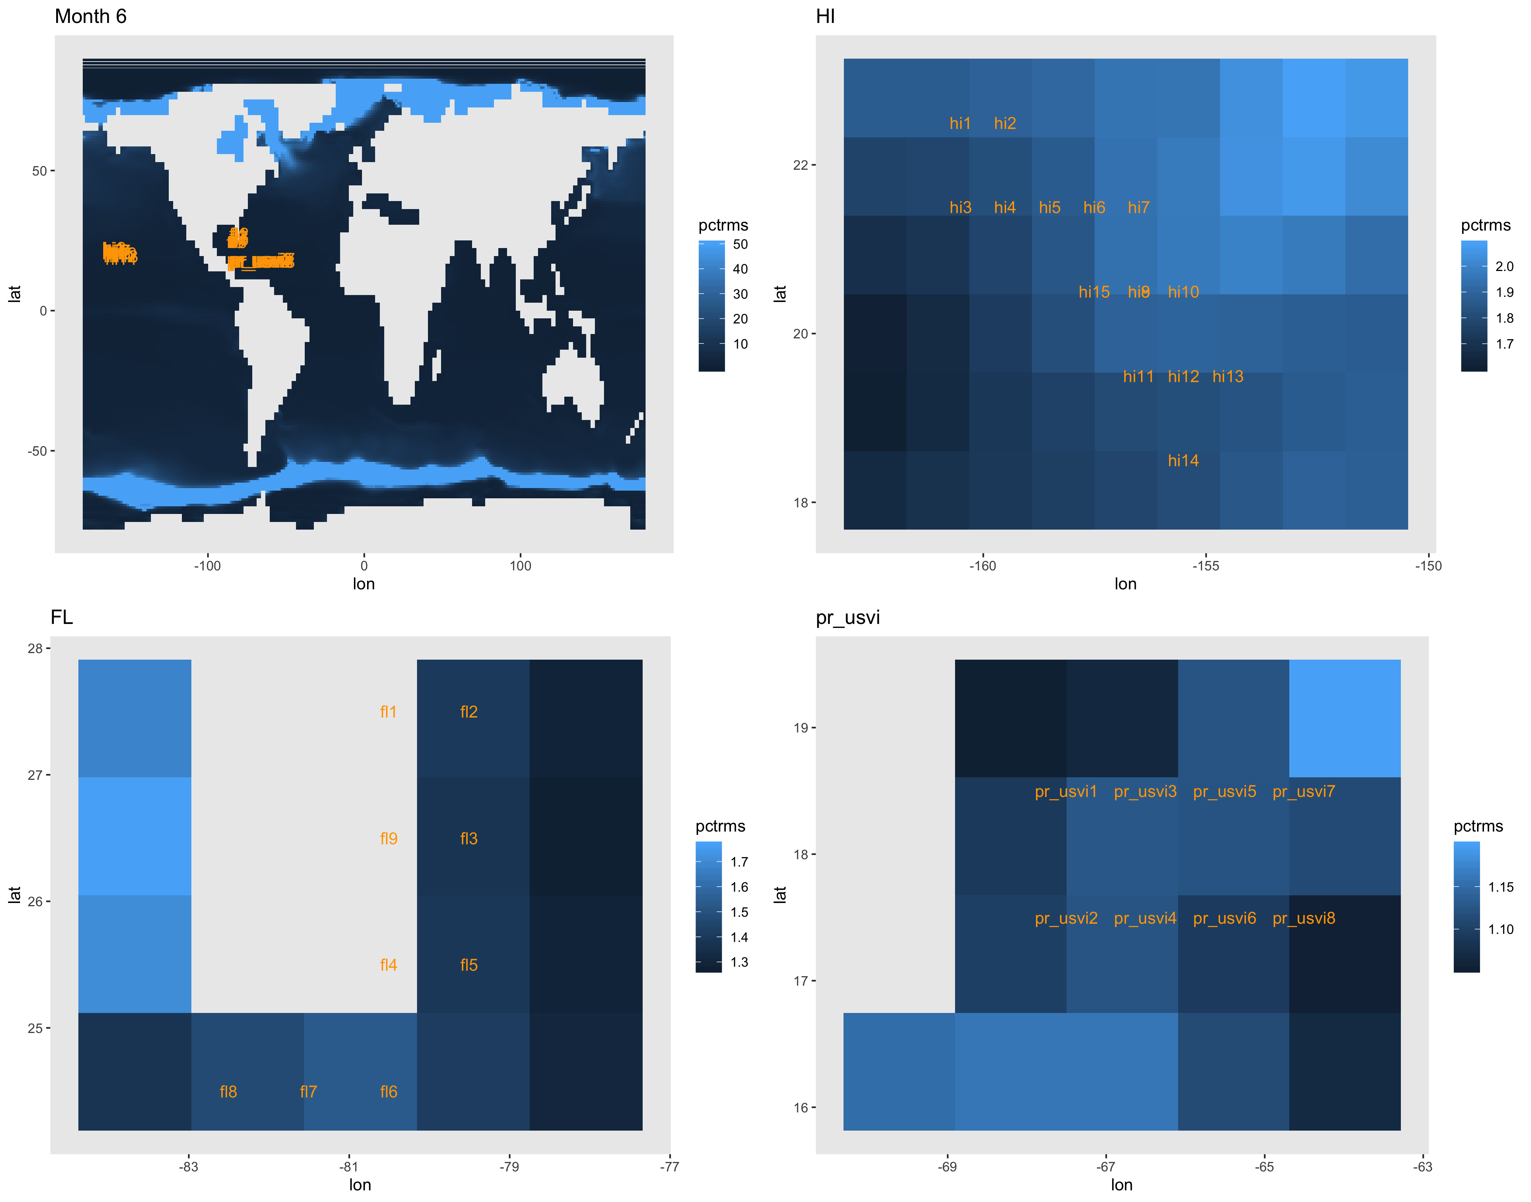

Slide 16
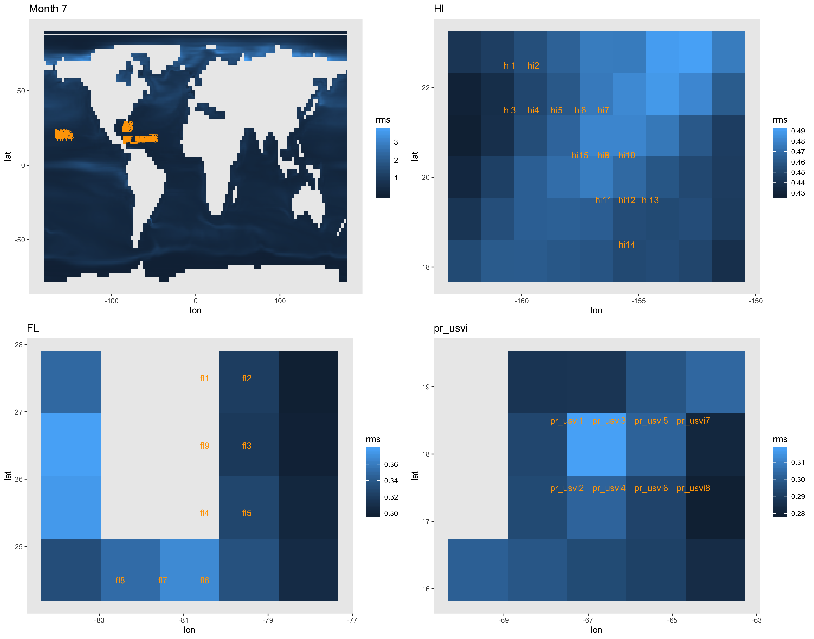
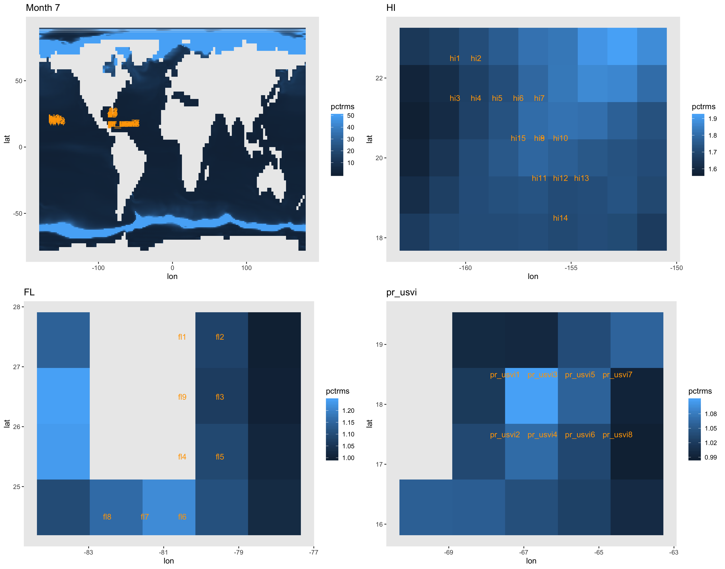

Slide 17
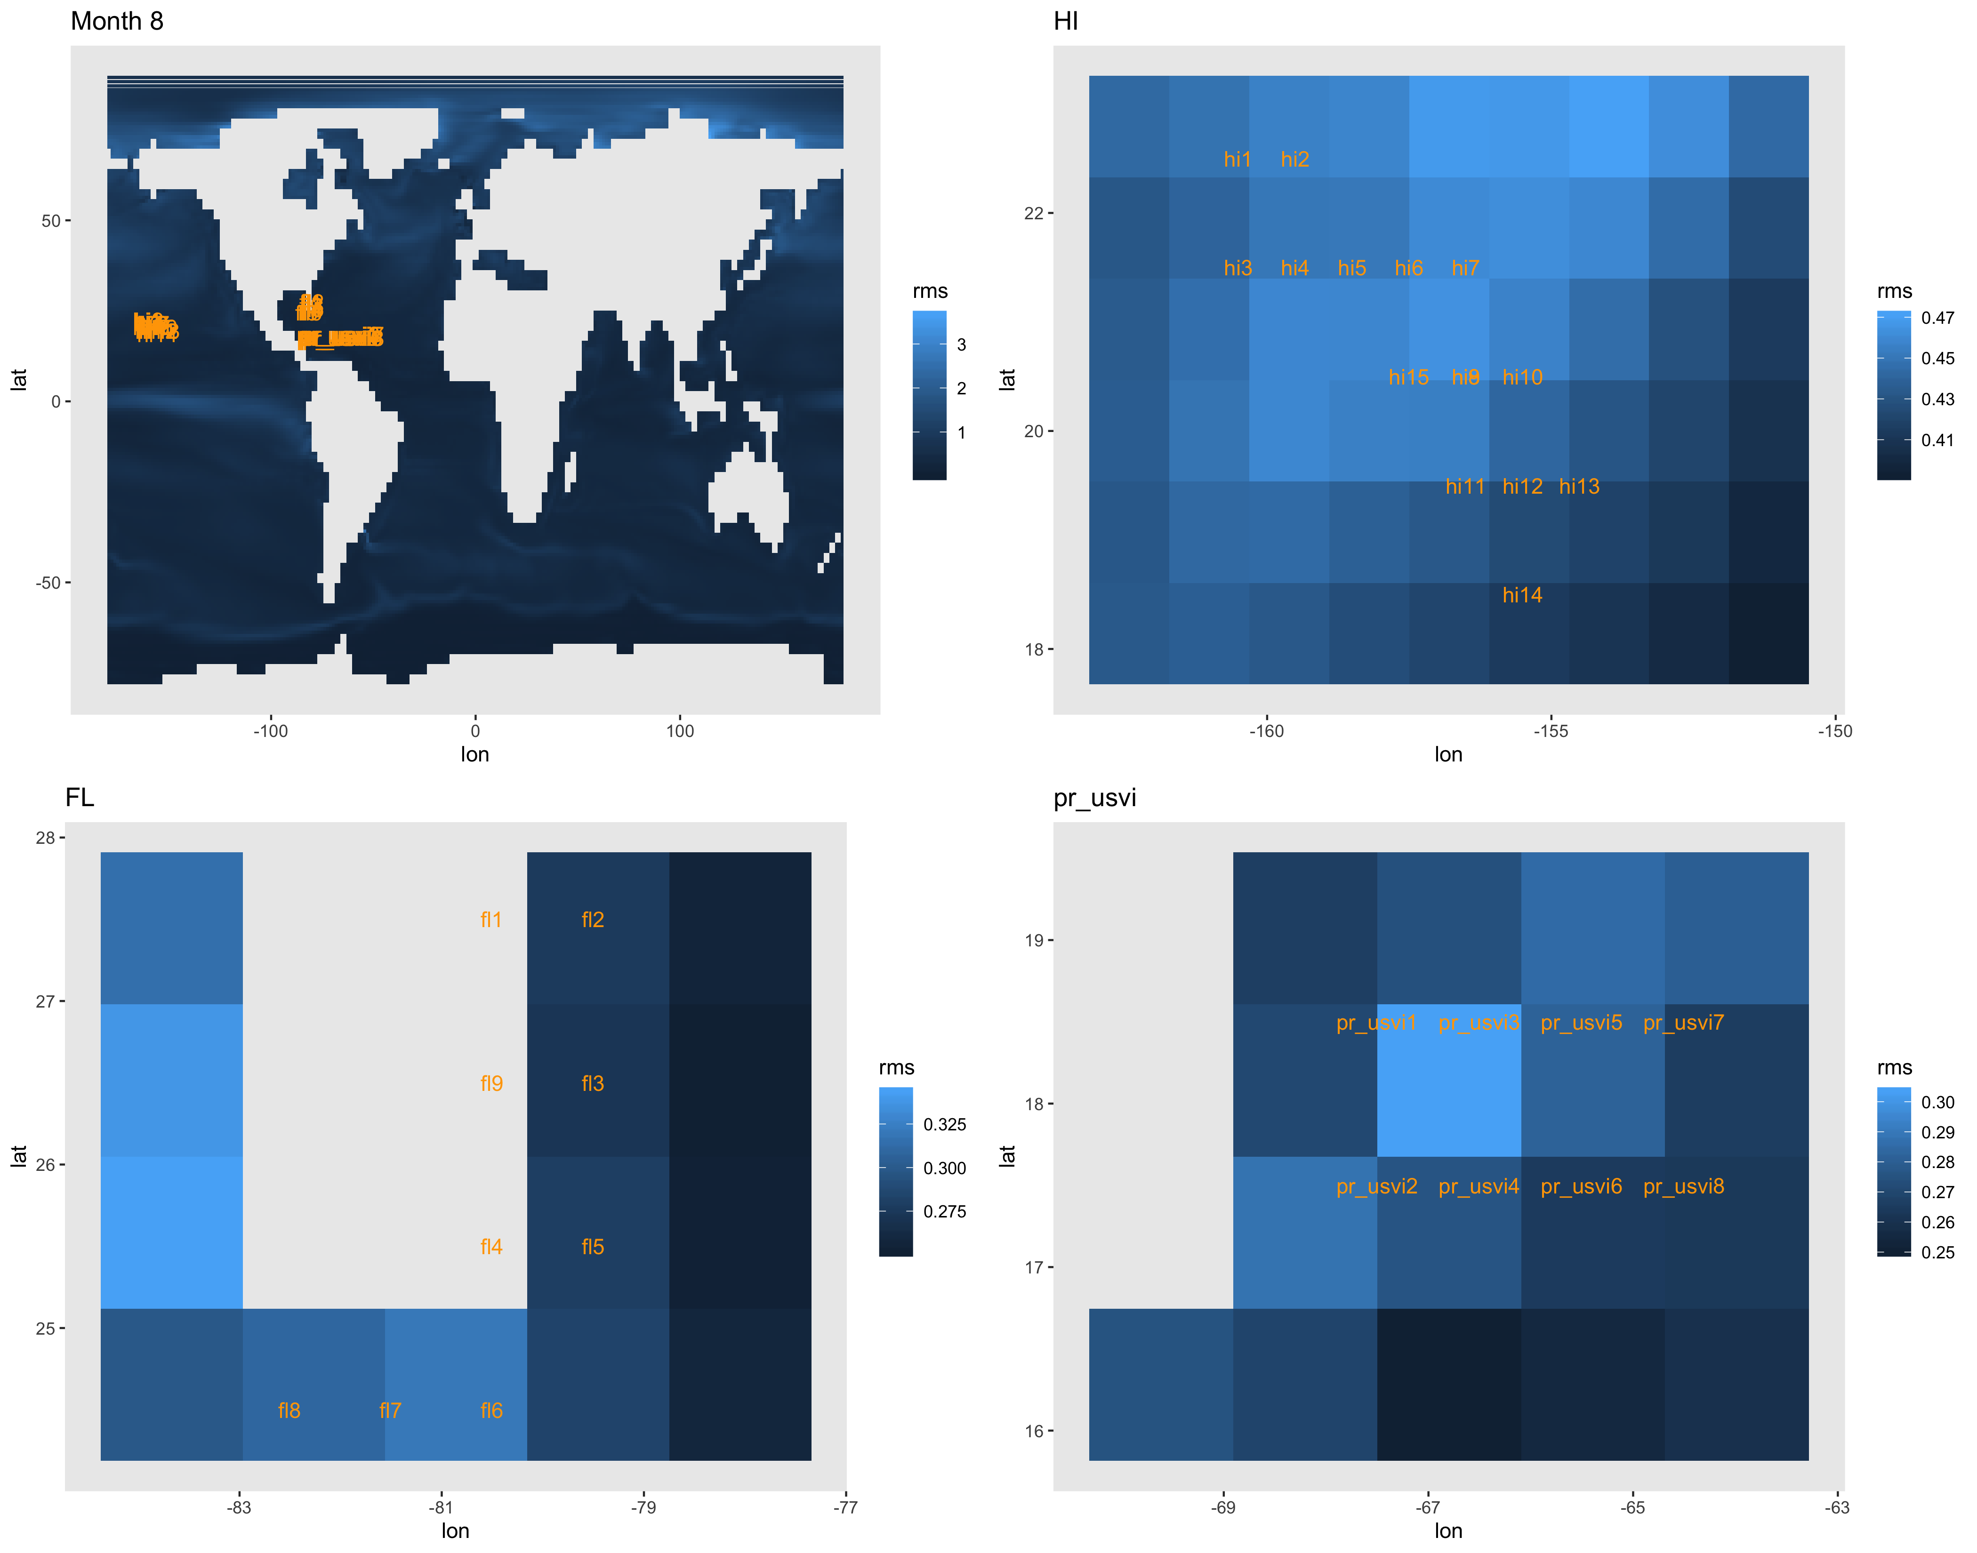
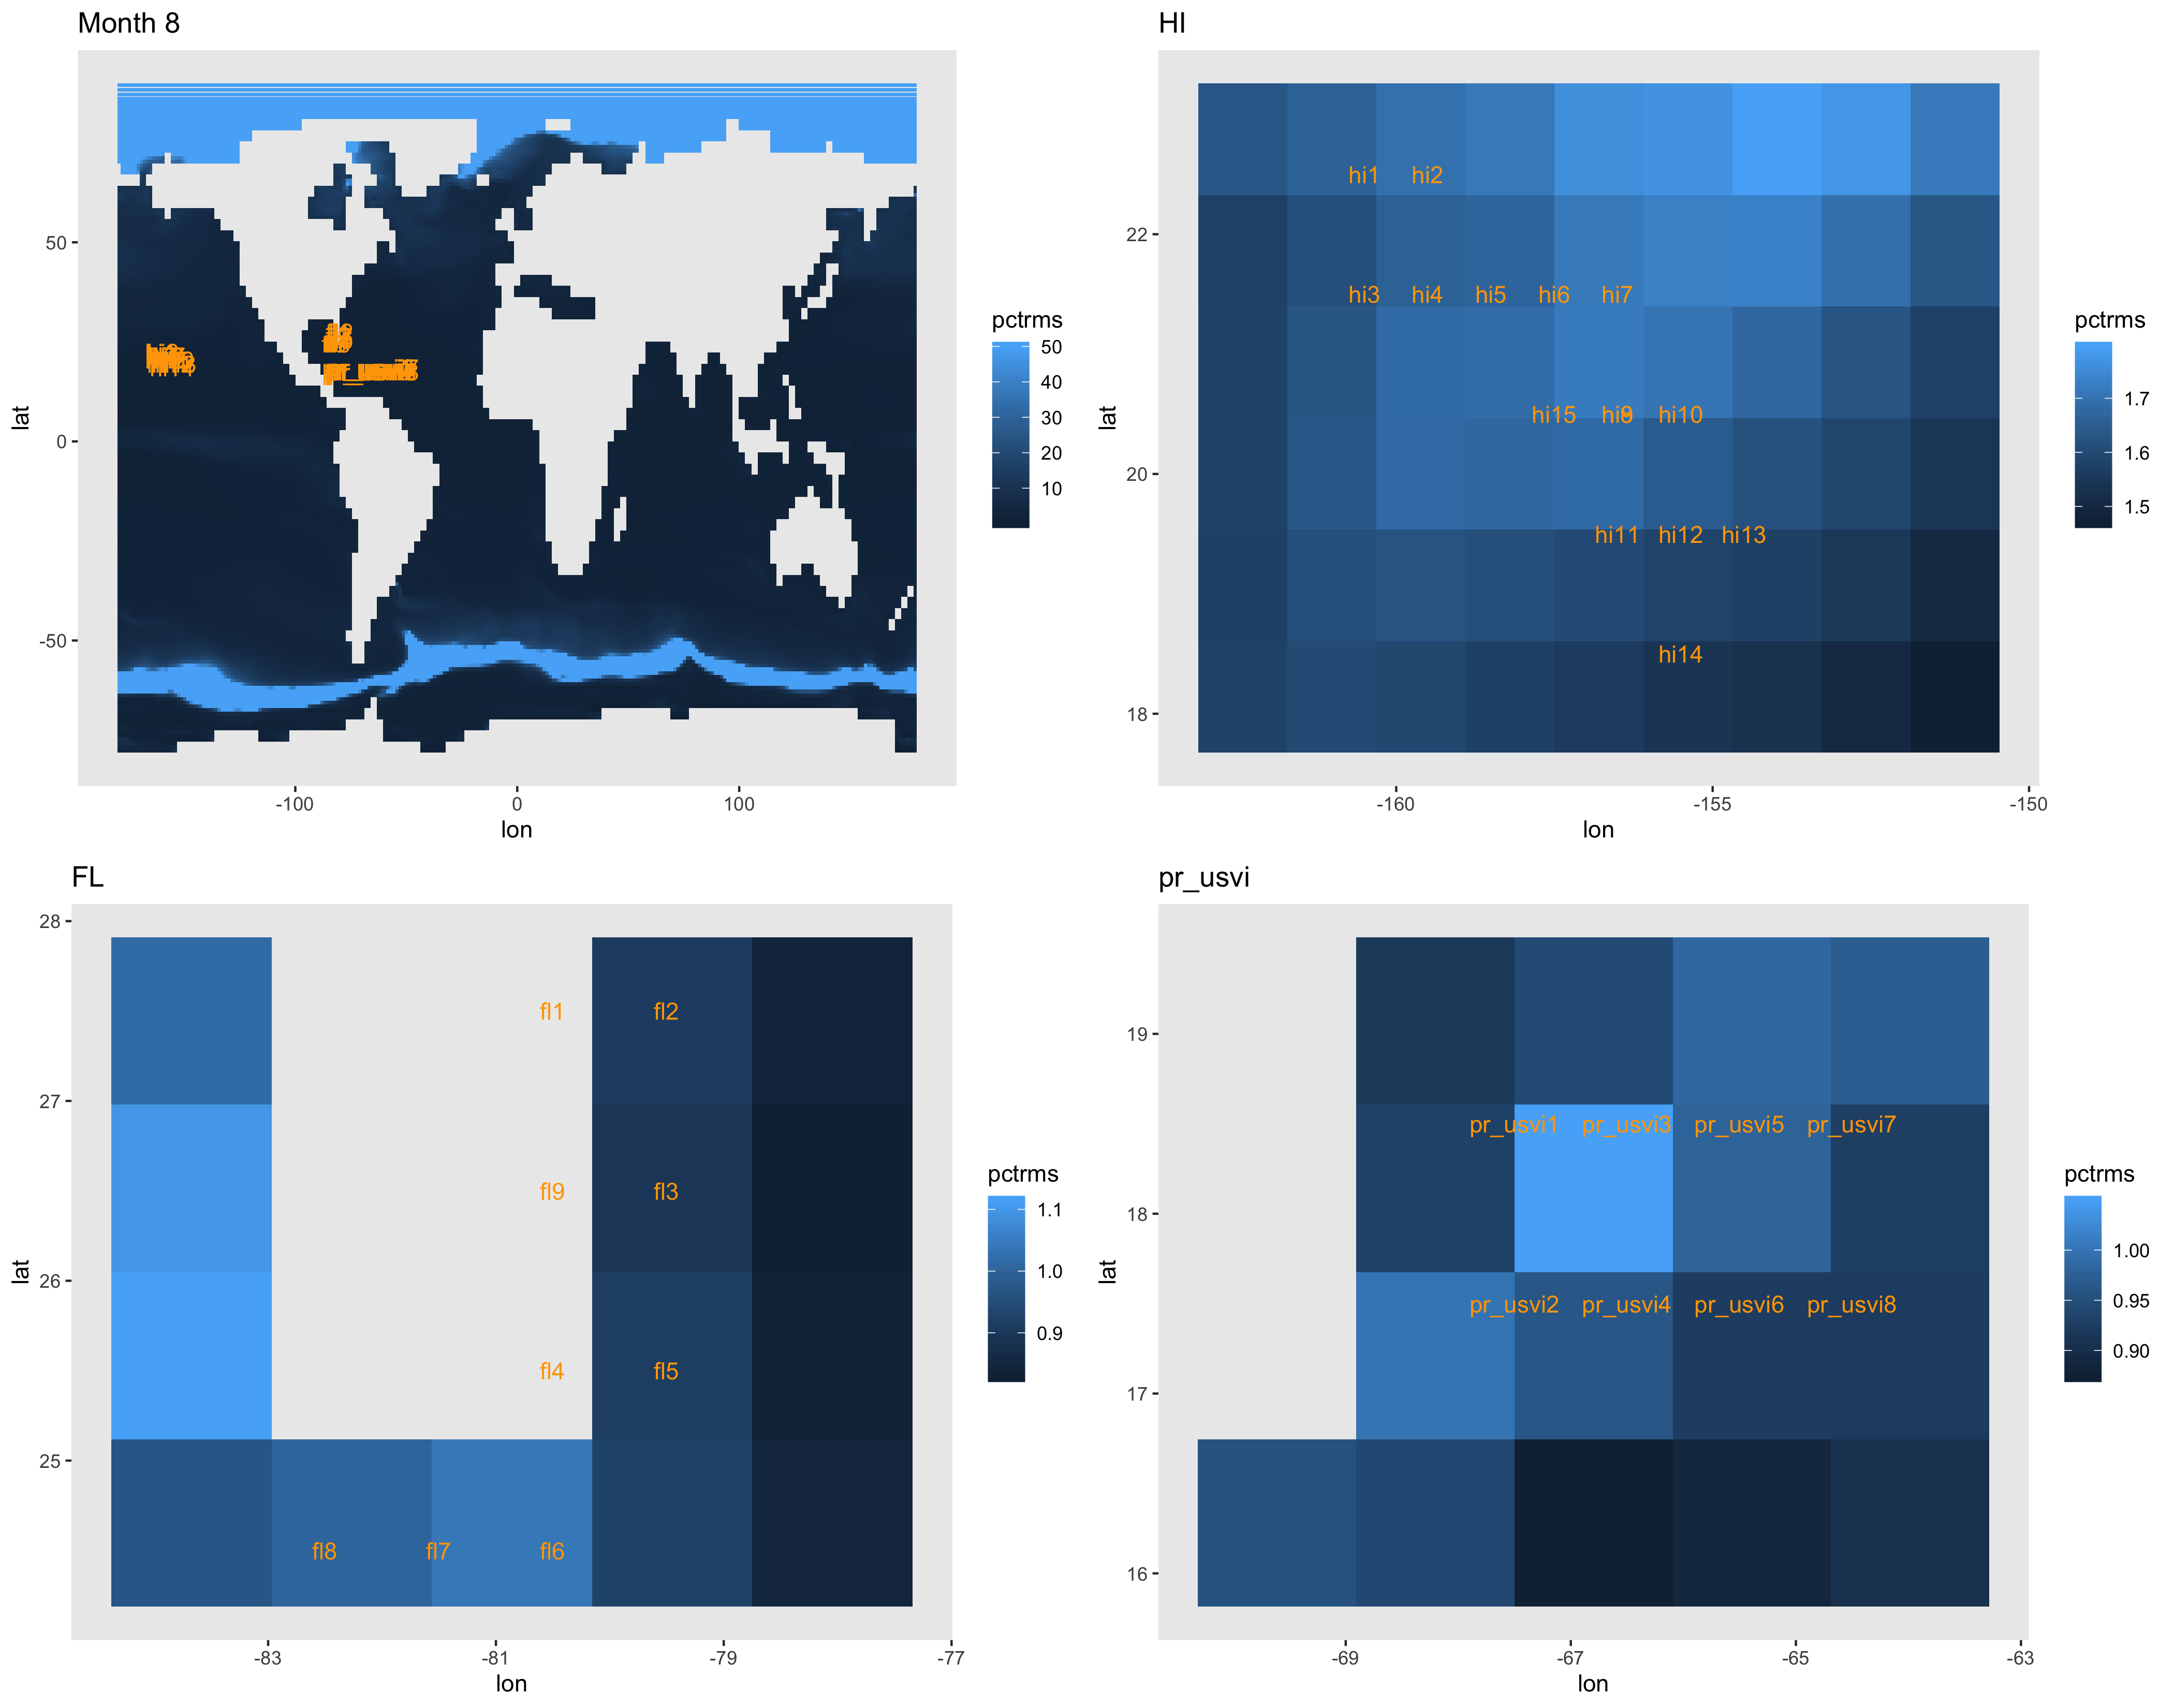

Slide 18
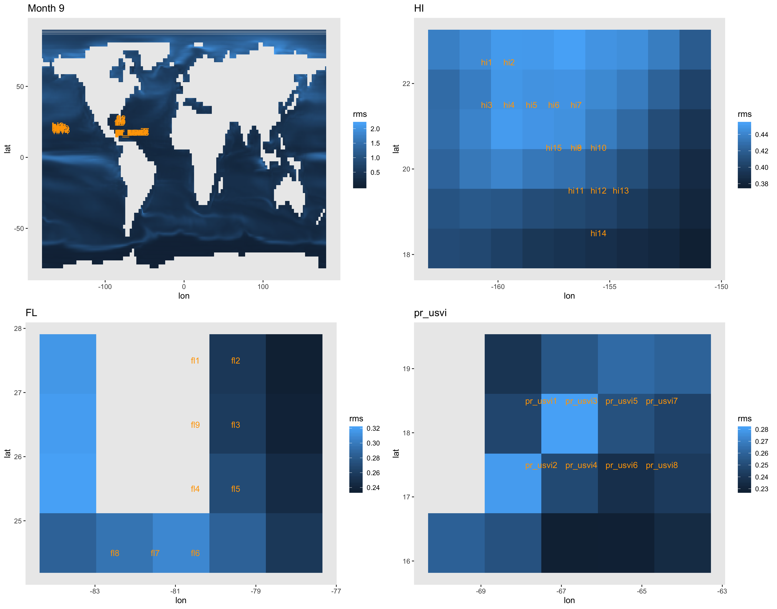
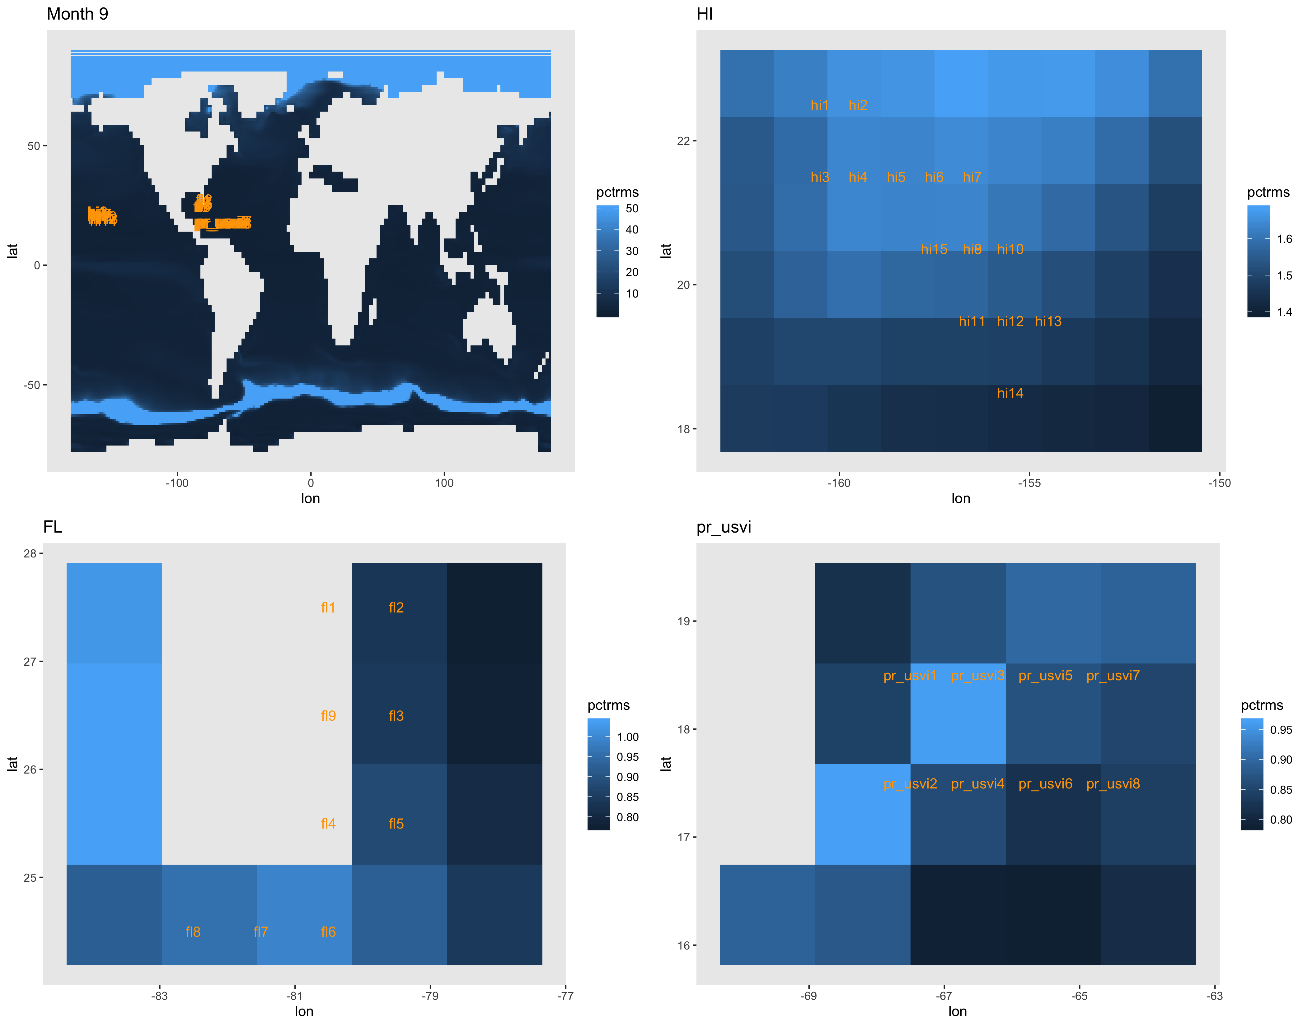

Slide 19
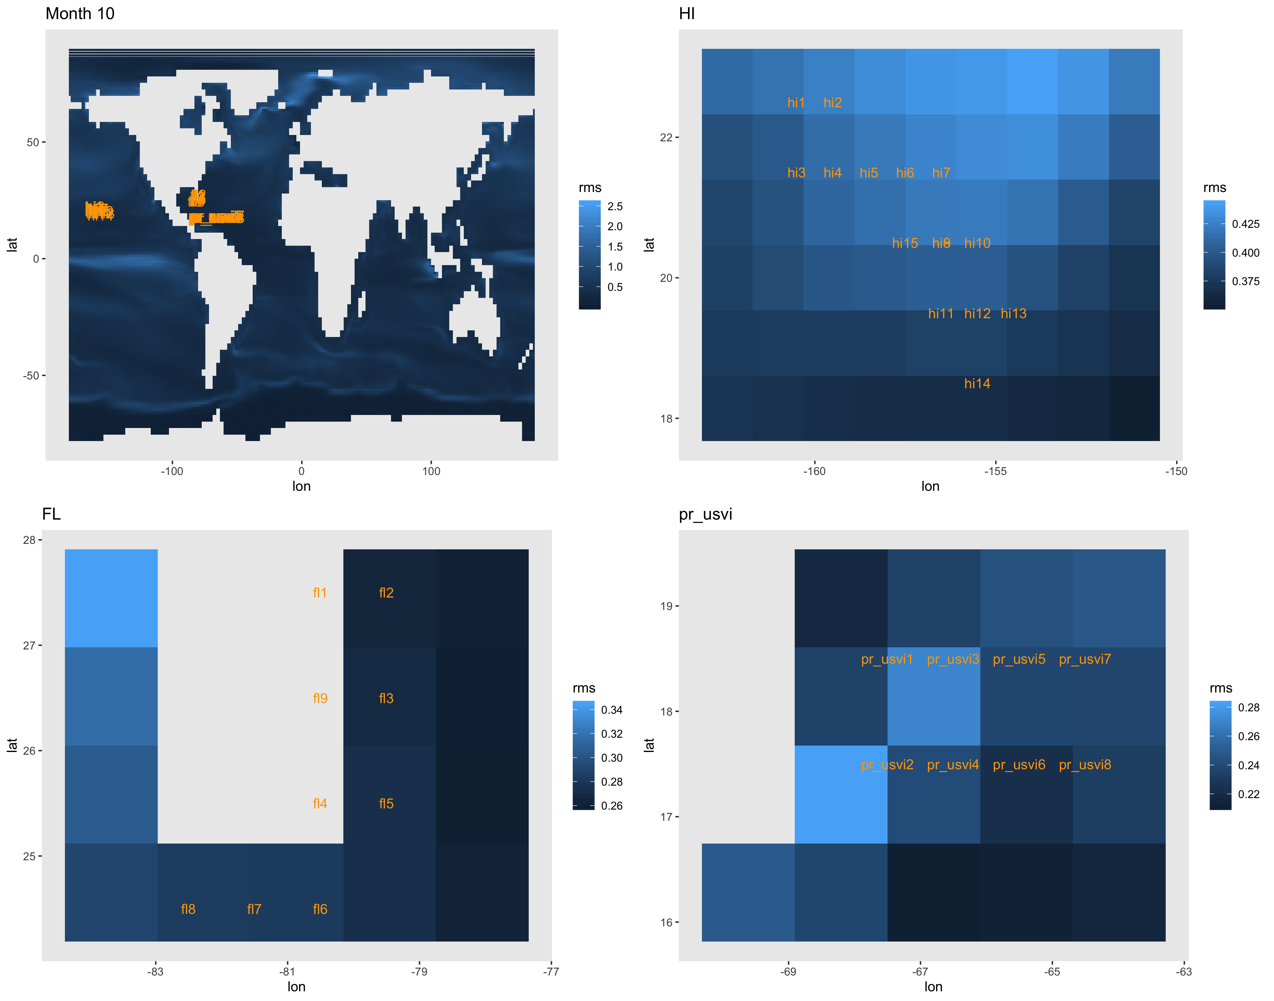
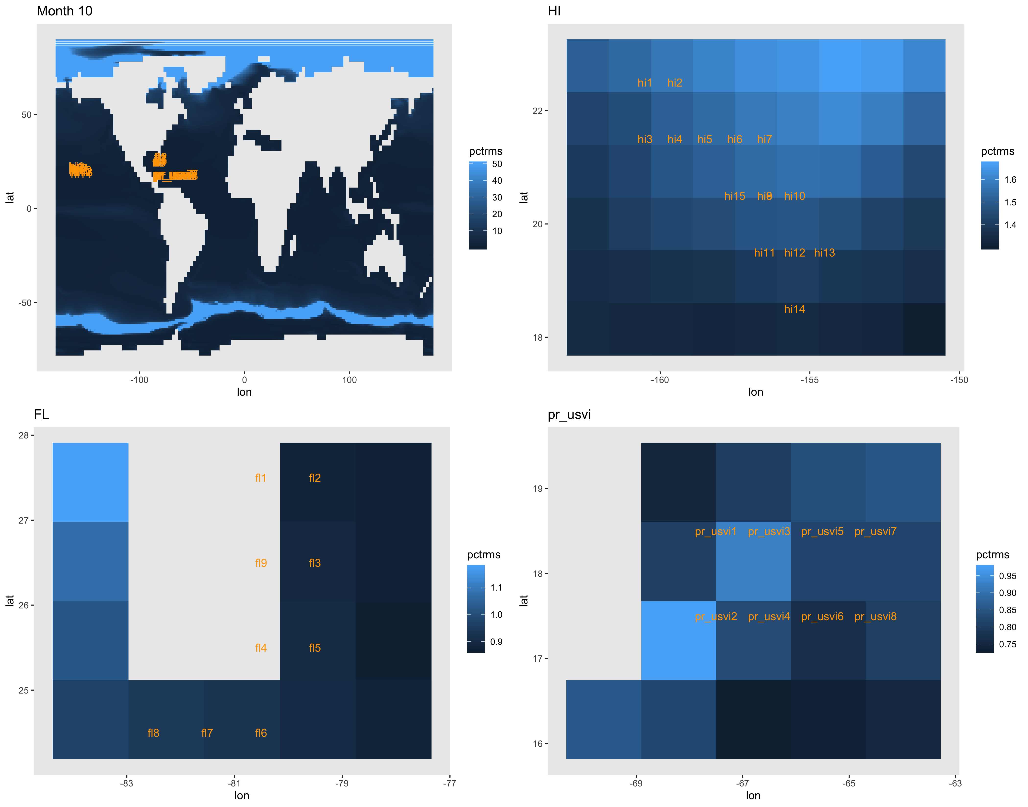

Slide 20
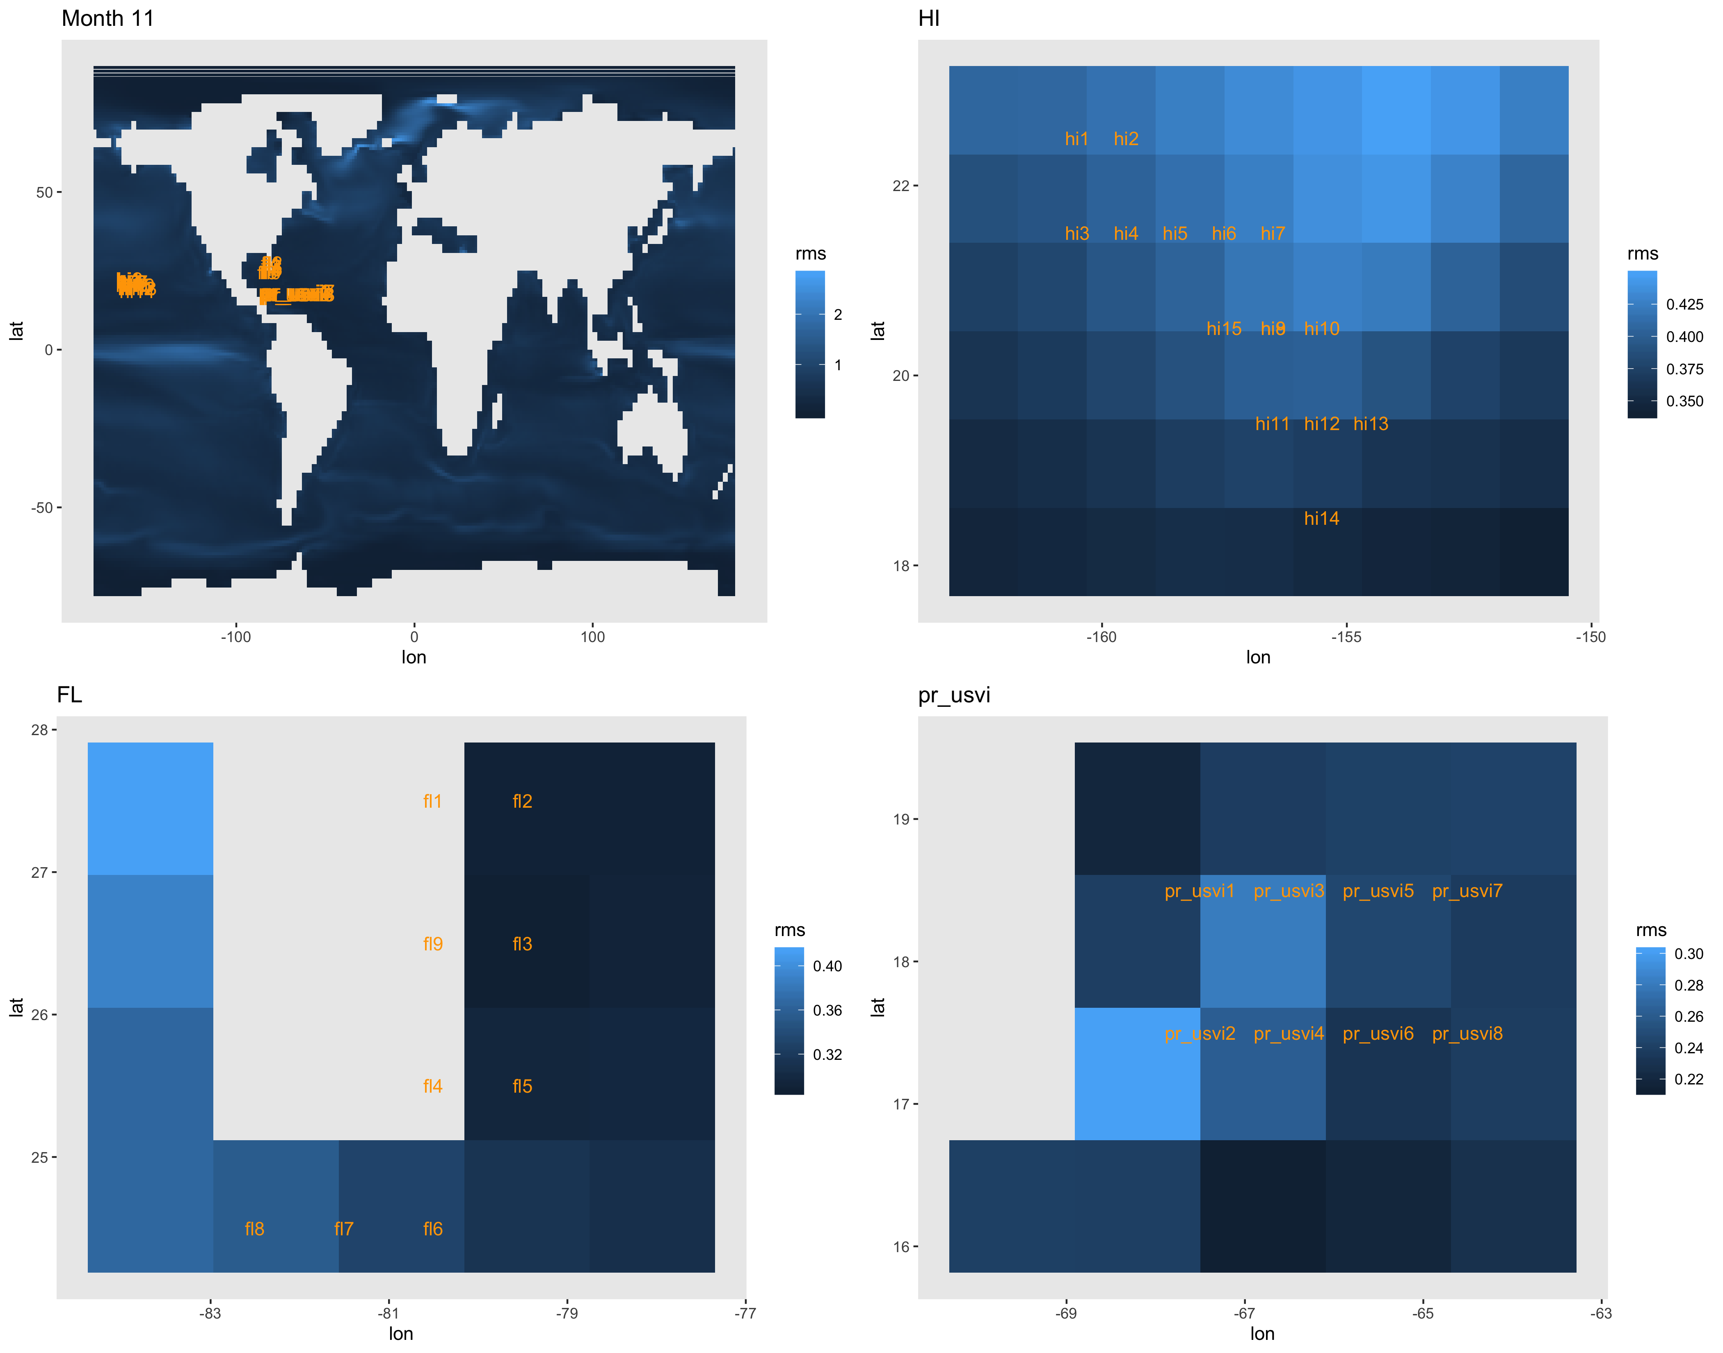
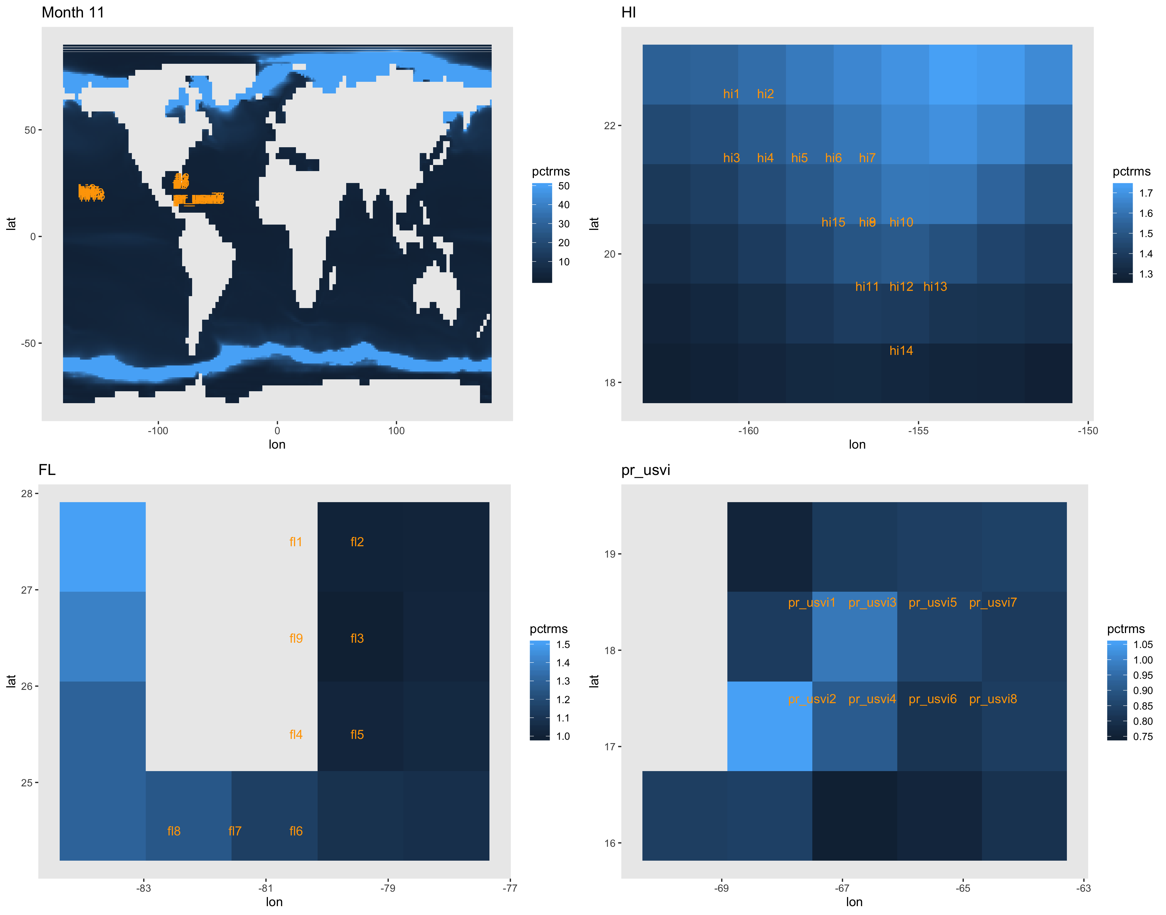

Slide 21
